Slide 1

Harnessing Space Technologies for
Comprehensive Homeland Security
Garry Singh
Garr@iirisconsulting.com
www.iirisconsulting.com
09 January 2025
© 2025 | Indus IntelliRisk IntelliSense Services Pvt. Ltd.

Slide 2

IIRIS Offerings Overview
IIRIS
IIRIS : COMPANY OVERVIEW

Slide 3


IIRIS Locations
Θ
Θ
Θ
Θ
Θ
Θ
Θ
Θ
Θ
Θ
Θ
Θ
Θ
IIRIS office
Strategic Partner Office
IIRIS has capability to operate globally through vetted partners other than own offices
Θ

Slide 4


OUR CREDIBILITY & INITIATIVES
Best Security Consulting Awards
Best Security Auditor of the Country
Best Security Design
Best Security Professional
03 TIMES
7 TIMES
03 TIMES
OSPAs Security Award
ASIS Young Professional Award
Times 40 Under 40
Investigation Personality of the Year
2020 & 2021
2021
Comptroller Auditor
General of India
Board Member
Parliamentary Committee on Review of Old Constitution Member
CCTV Standards
Chaired the first Indian Standard drafted for CCTV deployment
Women in Security Survey
Report 2022
India Risk Report – ET Now India First TV Show addressing Risk Management
Ministry of Science of Technology Part of Technology Need Identification for Indian Habitat in 2035

Slide 5
New Age Solution Making Difference with Digitization
GOVERNANCE & MIS
SOFTWARE
AI & ML PRODUCTS
CYBER MONITORING
DASHBAORD APP
SKILL AUGMENTATION
SMART REPOSITORY
COMMAND CENTER (SHARED)

Slide 6
SPACETECH Homeland Security
IIRIS
SPACETECH USE IN HOMELAND SECURITY

Slide 7

SPACETECH Unlimited Possibilities
MOST VAST – LEAST HARVESTED
RACE FOR DOMINATING SPACE
PROTECTION IN SPACE
PREVENTIVE – RESPONSE – POST INCIDENT
HOMELAND SECURITY MORE COMPLEX THAN BORDERS

Slide 8
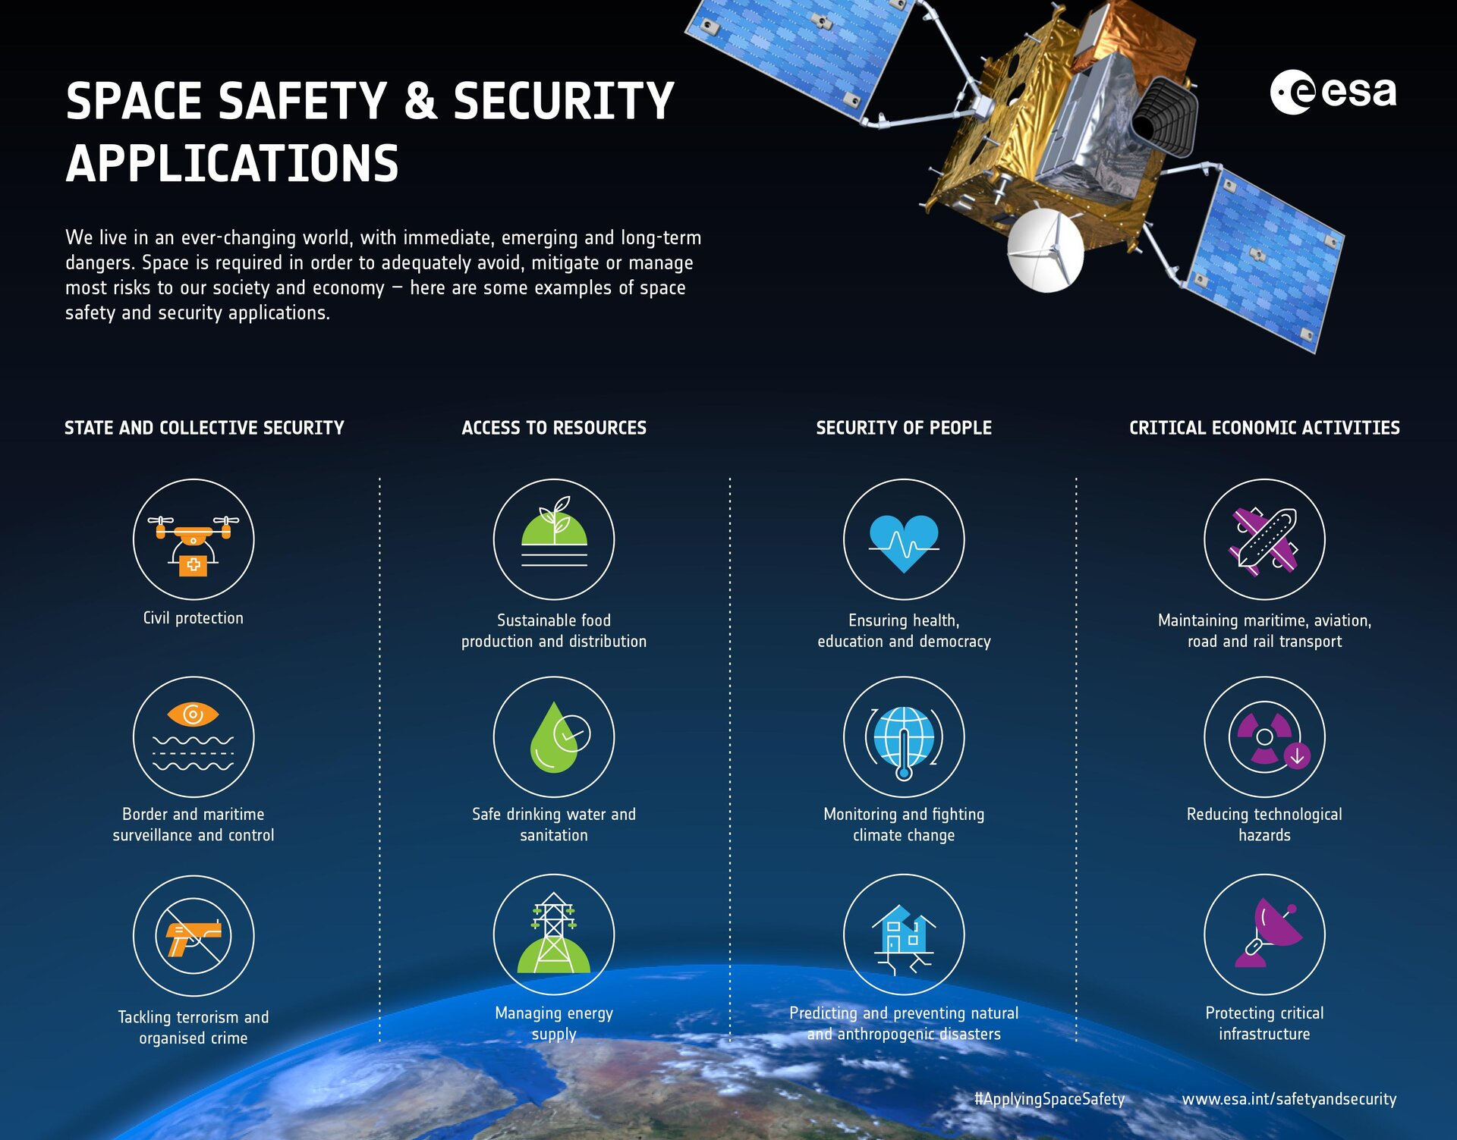
European Space Agency

Slide 9
Space Tech in Operational Effectiveness Situational Awareness
Application | Space Tech Used | How It Enhances Situational Awareness | Key Example/Data
Border Security | Cartosat-3, RISAT-2B, NavIC | Provides high-resolution imagery and real-time navigation data to monitor border infiltration and smuggling routes. | Cartosat-3 provides 25 cm spatial resolution imagery, enabling the detection of human activity and equipment movement near borders.
Law Enforcement | GSAT-6, GSAT-7A, NavIC | Enables secure communication and geo-positioning for tracking criminal activities and coordinating multi-agency responses. | GSAT-7A facilitates real-time encrypted communication across remote areas.
Counter-Insurgency | RISAT, Cartosat-2, GSAT-7A | Tracks insurgent hideouts, movement patterns, and supply routes even in dense forests and hilly terrains. | RISAT-2B provides all-weather, day-and-night surveillance capabilities.
Disaster Management | INSAT-3D, Oceansat-2, RISAT-1 | Offers early warnings for cyclones, floods, and forest fires, and provides damage assessment data post-disaster. | INSAT-3DR detected Cyclone Fani (2019) in advance, enabling the evacuation of 1.2 million people.

Slide 10
Space Tech in Decision Making Operational Effectiveness
Application | Space Tech Used | How It Enhances Operational Effectiveness | Key Example/Data
Border Security | Cartosat-3, GSAT-7A, NavIC | Real-time imagery and secure communications reduce delays in troop movement and deployment. | GSAT-7A supports secure military-grade communication links across borders.
Law Enforcement | RISAT-1, GSAT-6, NavIC | Real-time data integration supports swift tactical operations and resource deployment. | RISAT-1 data helped monitor and neutralize criminal gangs in remote areas.
Counter-Insurgency | RISAT-2B, GSAT-7A, Cartosat-2 | Surveillance and encrypted communication ensure precision strikes and coordinated responses. | RISAT-2B enabled tracking Maoist hideouts in Chhattisgarh forests.
Disaster Management | INSAT-3DR, Cartosat-2, ResourceSat | Satellite-based imagery and damage assessment streamline post-disaster rescue and rehabilitation operations. | INSAT-3DR detected Cyclone Yaas (2021), enabling preemptive evacuations.

Slide 11
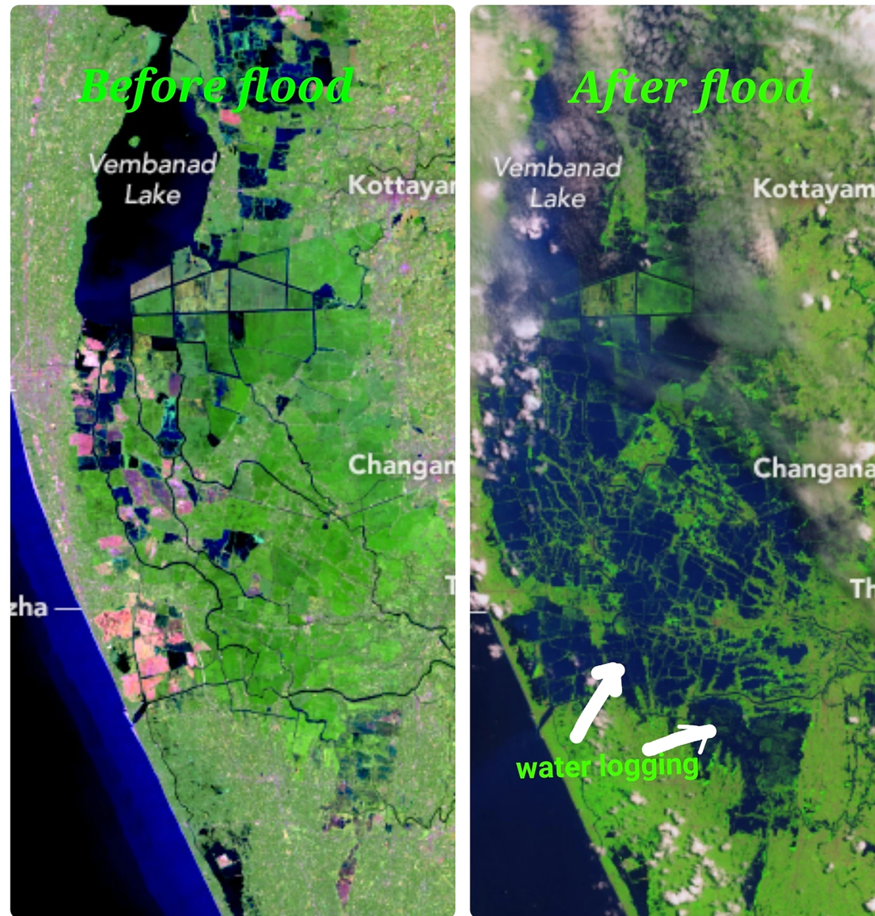
Space Technology: Disaster Management Case Study: Kerala Floods (2018)

Slide 12
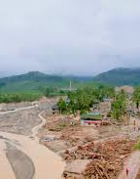
Case Study: Kerala Floods (2018) Thanks to ISRO
GSAT Communication: Enabled communication in regions where terrestrial networks failed.
NavIC Navigation: Guided rescue boats and helicopters to stranded victims.
RISAT-1 and Cartosat-2 Satellites: Provided flood extent mapping and damage assessment.

Slide 13
Thank You

