Slide 2
ARCHITECTURAL FRAMEWORK
MULTI DOMAIN OPERATIONS

Slide 3




Contents
1
Introduction to C4ISR
2
Inspiration for Architectural Framework
Yodha
3
Elements of Architectural Framework
4
Building Blocks of Framework
5
C4ISR Data Ontology
6
Implementation of AF

Slide 4
Introduction to C4ISR
A Summary

Slide 5
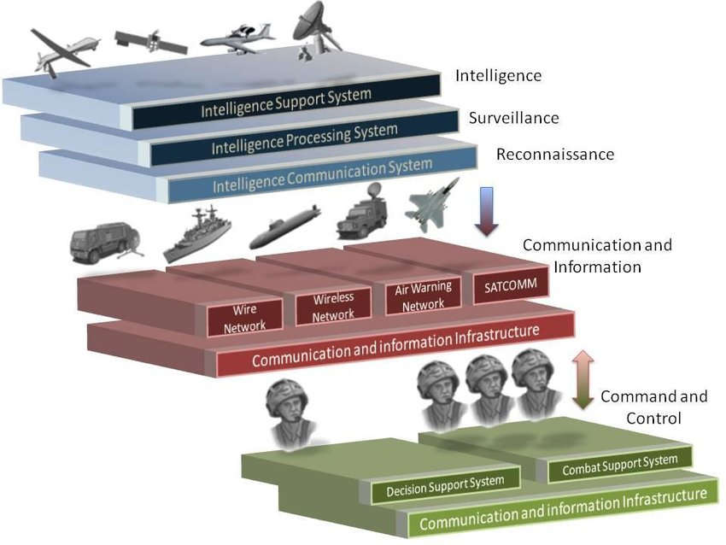
Elements of C4ISR
Command & Control
Communications
Computers
Intelligence
Surveillance & Reconnaissance

Slide 6
Constituents of C4ISR
Command & Control
Communications
Computers
Intelligence
Surveillance & Reconnaissance
Situation Awareness
Battle Management
Tasking & Coordination
Resource Allocation

Slide 7
Constituents of C4ISR
Command & Control
Communications
Computers
Intelligence
Surveillance & Reconnaissance
Data Transmission
Network Management
Net Centric Communications

Slide 8
Constituents of C4ISR
Command & Control
Communications
Computers
Intelligence
Surveillance & Reconnaissance
Data Processing
Data Storage
Software Applications
Cyber Security

Slide 9
Constituents of C4ISR
Command & Control
Communications
Computers
Intelligence
Surveillance & Reconnaissance
Intelligence Collection
Intelligence Analysis
Intelligence Dissemination

Slide 10
Constituents of C4ISR
Command & Control
Communications
Computers
Intelligence
Surveillance & Reconnaissance
Sensor Integration
Target Detection
Target Tracking
Geospatial Intelligence

Slide 11
Key Technologies of Modern C4ISR
Robust Interface to Diverse Origin Weapons, Sensors, Autonomous Systems and Internet of Battlefield Things (IoBT)
Multi Platform Multi Sensor Data Fusion (MPMSDF)
Secure Networking through Tactical and Strategic Datalinks.
Integrated with Modern & Intuitive User Interface
Traditional rule based Algorithms for
Common Operational Picture
Threat Evaluation & Resource Allocation
Centralised & Autonomous control of Sensors and Weapons

Slide 12
Key Technologies of Modern C4ISR
AI/ML based Data Analytics & Algorithms for
Object Detection, Identification & Classification
Recommend Best course of Action
Resource Optimisation
Simulation & Wargaming

Slide 13
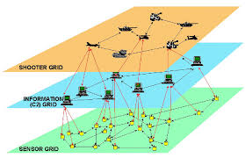
C4ISR Implementation: Sensor – Shooter Grid
Forms a seamless chain from Detection to Engagement
Network of Sensors to detect targets
Pass information through Information Grid
Quick and Precision Targeting by shooters

Slide 14
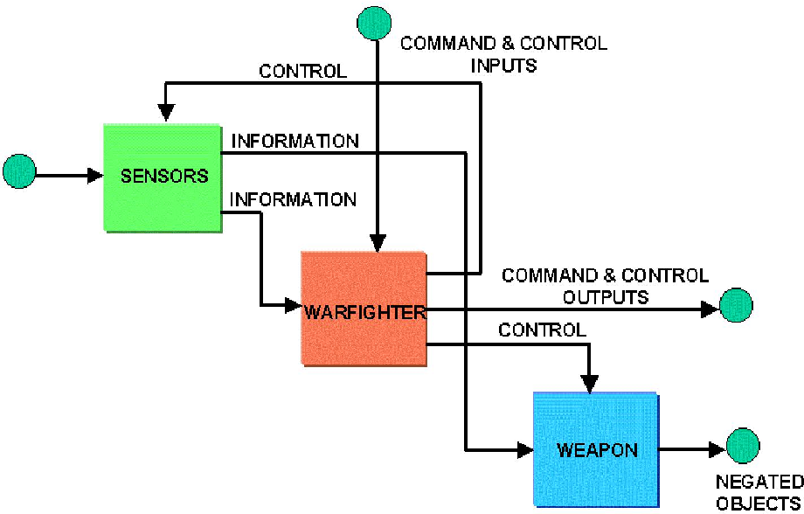
C4ISR Implementation: Sensor – Shooter Grid

Slide 15
C4ISR Implementation: Operational Levels
Strategic Level
High Level, Long Term Planning
Operational Level
Mid Level Planning
Coordinate large scale Military Operations
Tactical Level
Immediate Actions & Manoeuvres
Individual Engagements
Layered Architecture
Control Interface from higher to Lower
View Interface from Lower to Higher
Strategic Level
Control
View
Operational Level
Control
View
Tactical Level

Slide 16


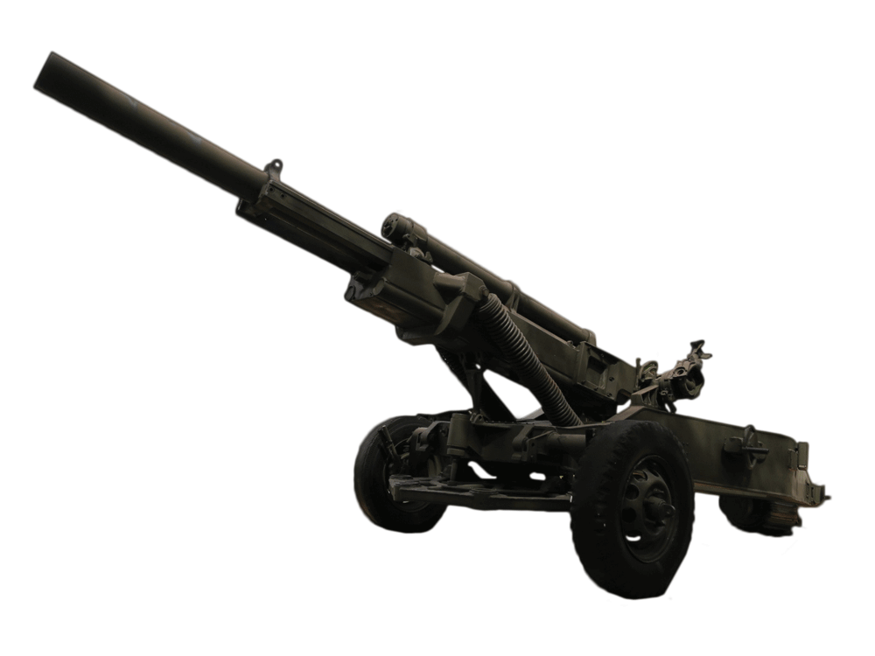







Bird’s Eye View
Howitzer
Command Centre
Wireless Network
Tank
Drone
Strategic Network
Tactical Network
Mobile Post
Helo
Wireless Network
Command Post
Mortar
Command Post
Soldier

Slide 17
C4ISR Implementation: Operational Levels
Situational Awareness
Multi Platform Multi Sensor Data Fusion
Threat Evaluation
Data Analytics
Strategic Planning & Control
Strategic
Operational Planning & Control
Operational
Weapon Control
Tactical

Slide 18
Architectural Framework
The Inspiration

Slide 19
Why we need a Framework?
Present Approach to Multi Domain Operation Systems
Build Individual Systems with Specific Capabilities
Build Interoperability between Systems where needed
No common Framework for Design & Development
Interoperability Issues
No common Data Language
Interoperability not Designed-in. Often an after thought
Lack of Systems-of-Systems approach – Systems Engineering

Slide 20
Why we need a Framework?
Scalability Issues
Data overload Issues
Heterogenous Integration Challenges
User Interface Complexity
Extensibility Issues
Tight coupling of system design to Narrow User Requirements
Lack of Data Coherence
Non availability of Common Framework

Slide 21
Elements of AF
A Summary

Slide 22
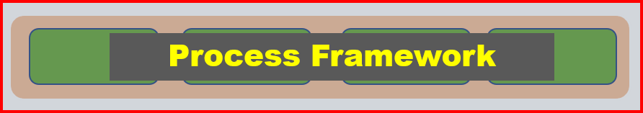
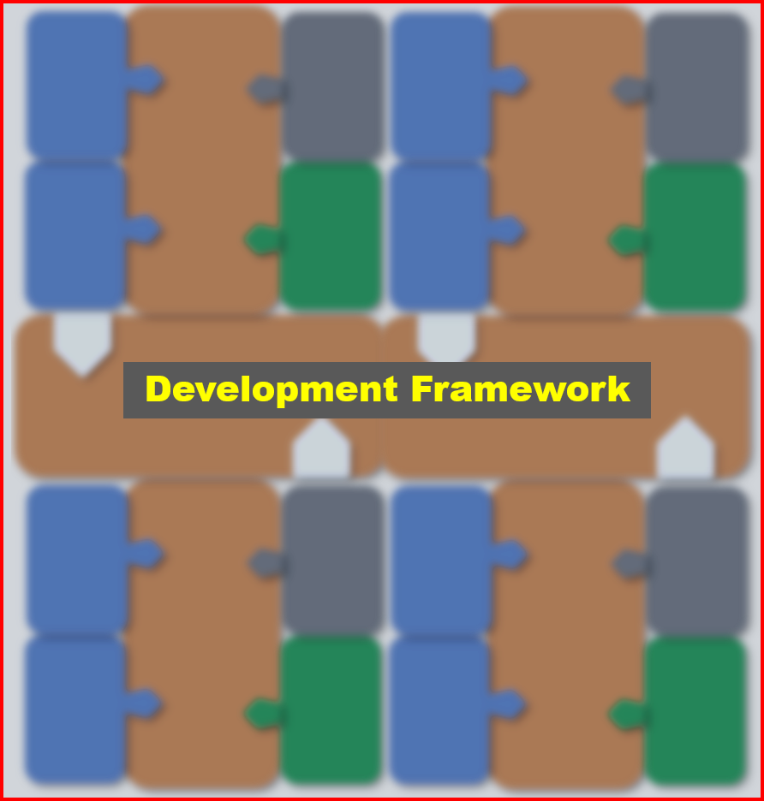

Framework Components
The AF Triad

Slide 23
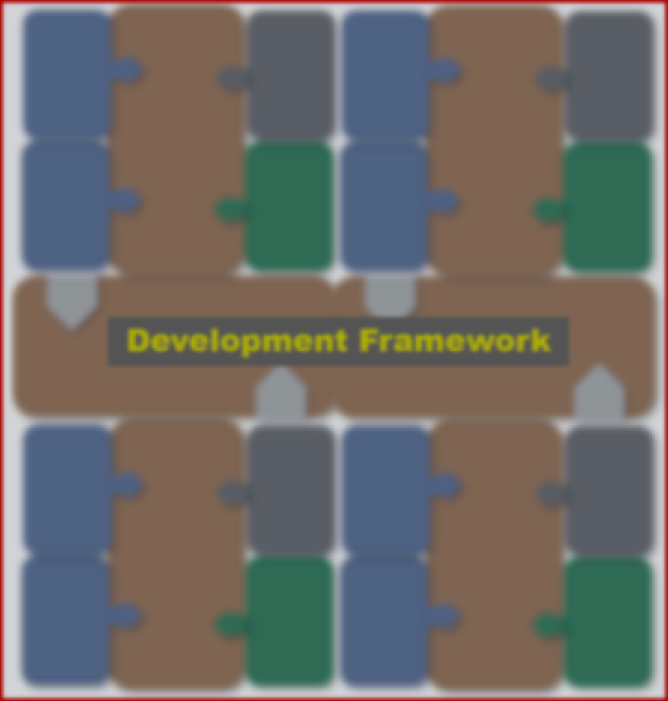

Process Framework
In accordance with ISO/IEC 15288
Defined Organisational level processes
Agreement Processes
Organisational Project Enabling Processes
Technical Processes
Project Processes
All processes defined in terms of
Policies
Procedures
Templates
Checklists

Slide 24
Systems Engineering Framework
Structured approach to systems engineering
In accordance with INCOSE Standards
Eight well-defined Stages
Requirement Derivation
Functional Analysis
Logical Analysis
Component Specification
Component Verification
Integration
System Verification
Validation

Slide 25
Development Framework
Technical Framework for Design & Development
Integrated Design Team with
Systems Engineers
Domain Specialists
Software Design Engineers
Data Scientists
Framework defines two components
C4ISR Data Ontology
Application Building Blocks

Slide 26


Development Framework Components
Data Ontology
Development Framework
Design (Top Down)
Building Blocks
Develop (Bottom Up)

Slide 27
Building Blocks of DDF
An Overview

Slide 28
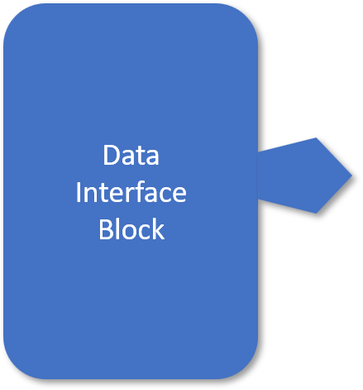
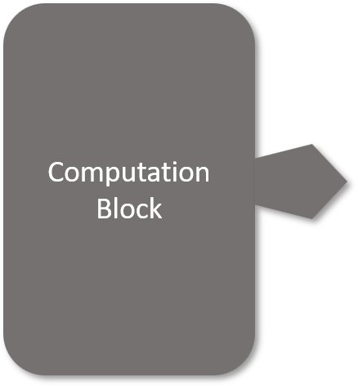
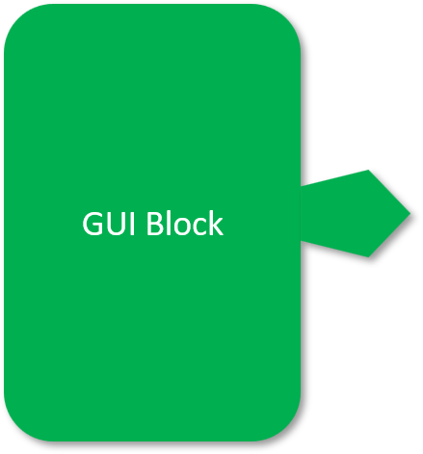

Building Blocks
Four Building Blocks defined
Interface Block
Computation Block
GUI Block
Communication Block

Slide 29
Data Interface Block
Encapsulates all data Interfaces
Multivariate Inputs, Standard Outputs
Data translation as per Data Dictionary
Data Hook links each block to Communication Block
Data Output is as per C4ISR Ontology

Slide 30
Data Interface Types
Analog
Digital
Interfaces
Video
Audio
RF
Serial
Parallel
Ethernet

Slide 31
Protocols & Interfaces
SSH, HTTP, FTP, SMTP
Application Layer
7
SSL, IMAP, ASTERIX, MPEG
Presentation Layer
6
NetBIOS, SSH
Session Layer
5
Transport Layer
TCP, UDP, SCTP
4
Network Layer
IP, ICMP, IGMP
3
Data Link Layer
HDLC, Frame Relay, ATM
2
Physical Layer
Ethernet, WiFi, PPP, SLIP
1

Slide 32
Computation Block
Encapsulates all Computation Elements
Core Computation Blocks
MPMSDF
Threat Evaluation
Resource Allocation
Mission Planning
Logistics Planning
Tactical Datalink
Track Data Management
Blocks defined at appropriate levels
All interfaces as per C4ISR Ontology

Slide 33
Graphic User Interface Block
Implements all User Interface Elements
MVC Architecture for Responsive GUI
Includes all standard Interfaces
Screens, Touch Screens
Joysticks, Track Pads, Knobs
Widgets for Graphical Data
Widgets for Tabular Data
Keyboard, Mouse
Blocks are modelled as OS Agnostic
Extensive use of GUI Implementation Tools

Slide 34
Communication Block
Serves as the Glue between various Blocks
Implements the Data Communication layer
C4ISR Ontology defined and Implemented
All Data hooks are supported out of the box
Supports various Communication Protocols
Incorporates the Data Security layer as overlay

Slide 35
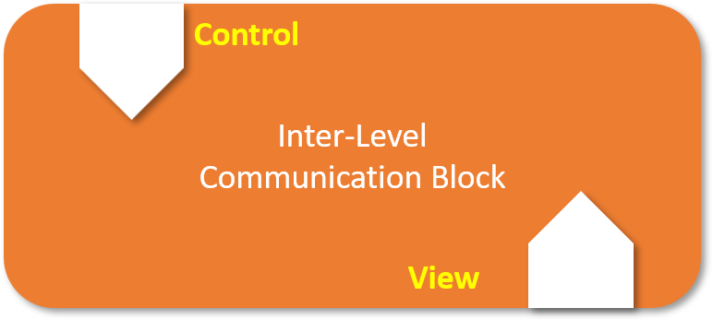
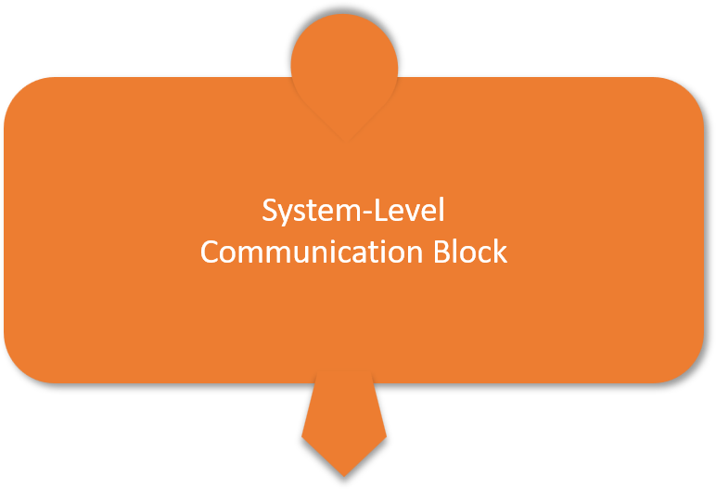
Types of Communication Blocks
Inter Level Comm.
System Level Comm.
Internal Comm.

Slide 36
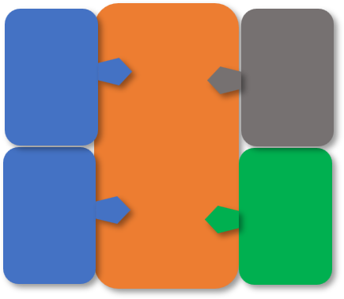
System Block
System defined as a group of closely integrated Blocks
Data Interface Blocks for all interfaces
Communication Block for interblock Communication
Computation Block for all computations
GUI Block for all User Interfaces
All blocks bind based on C4ISR Ontology

Slide 37
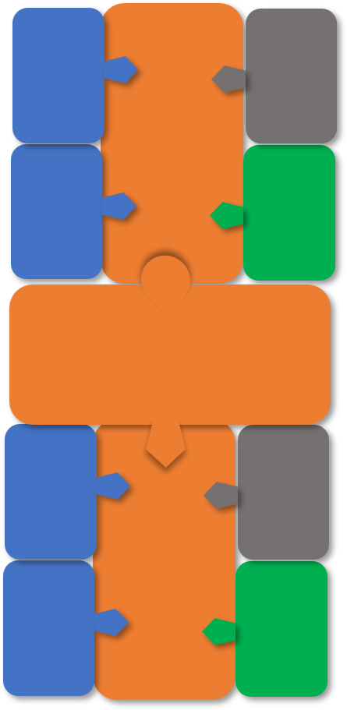
System of System Block
SoS designed as closely integrated Systems.
Two System Blocks connected through a System Level Communication Block
Inter System interfaces finalised from larger C4ISR Data Dictionary
Communication backbone handled by System Level Communication Block
All standard Communication Protocols supported

Slide 38

Multi Level System Block
Multi Level Systems implemented through integration of Systems or System-of-Systems
System Blocks connected through a System Level Communication Block
Lower level provides View Interface to Higher Level
Lower level accepts Control Interface from Higher Levels

Slide 39
C4ISR Data Ontology
An Overview

Slide 40
What is Data Ontology
Structured representation of data concepts and relationships that helps organize, access, and understand data
Systematic mapping of data to meaningful semantic concepts.
Map that links together data and meaning by defining what is meaningful.
It is the connective tissue between data and applications.
Common Data Language using same Data Dictionary
Data Ontology is Domain Specific

Slide 41
Why is Data Ontology Required?
‘Tower of Babel’ Legend
Creates a common vocabulary for all participants in a data ecosystem.
Empowers data integration, application building, user collaboration, and many other functions
Unifies disparate data sources and systems, enabling collaboration
With an effective ontology, System Design Paradigm has two Tasks
Data integration task is mapping raw data to an ontology
Application building task is creating ways to interact with ontological objects.

Slide 42
C4ISR Data Ontology
Inspired from OWL (Web Ontology Language) & RDF (Resource Description Framework) : offshoots of DARPA Agent Markup Language
Guided by Domain Driven Design (DDD) approach
Defined in terms of a model consisting of Entities and Value Objects.
Comprehensive repository of Entities and Value Objects in the bounded context of C4ISR Domain

Slide 43
Features of Our Data Ontology
Objects, Attributes, and Relationships defined and tied together to build the object graph
Ontology definitions are dynamic
Logic associated with objects is dynamic
Possible to introduce new object, attribute, and relationship types
Possible to change existing ones.

Slide 44
Implementation of DDF
Examples

Slide 45

Yodha Family of Systems
Baseline 1
Baseline 2
Baseline 3
Yodha

Slide 46
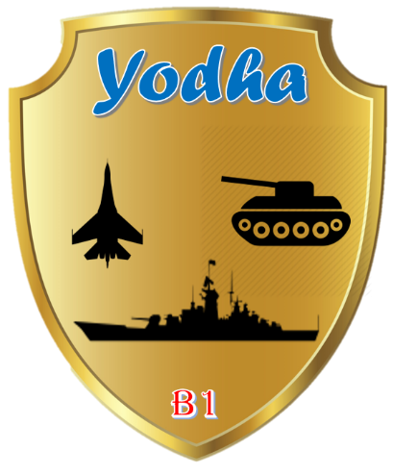
Yodha Baseline 1
Navy Specific Capabilities
Common Operational Picture
Tight Integration with Weapon & Sensors
Datalink integration for Task Group operations
Fleet level planning capabilities
Tactical navigation for Non-combat operations
Special features for Asymmetric operations
Fleet Management
Gunfire Support
Datalink Control
Shared Situation Awareness
Command & Control
Warfare Support

Slide 47
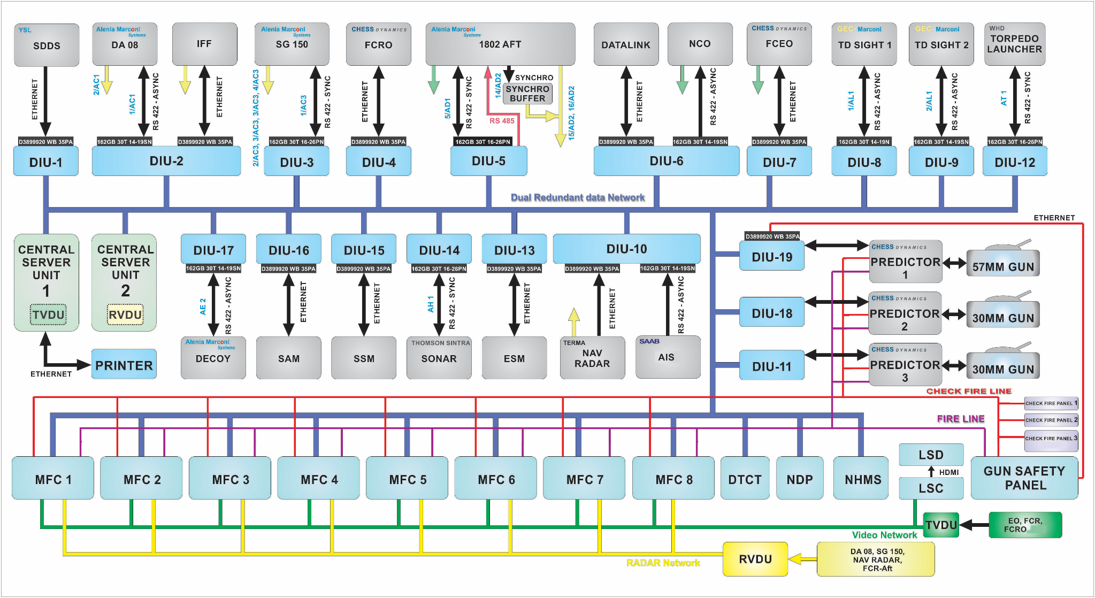
Deployment onboard Naval Warship

Slide 48

Yodha Baseline 2
Shared Situation Awareness across echelons
AD Planning, Threat Eval & Weapon Allocation
Fire Support for Mortars, Cannons, Rockets & Missiles
Battlefield Management component for Mission Planning, Decision Support
Communication
Battlefield Management
Intelligence & Electronic Warfare
Shared Situation Awareness
Fire Support
Air Defense

Slide 49
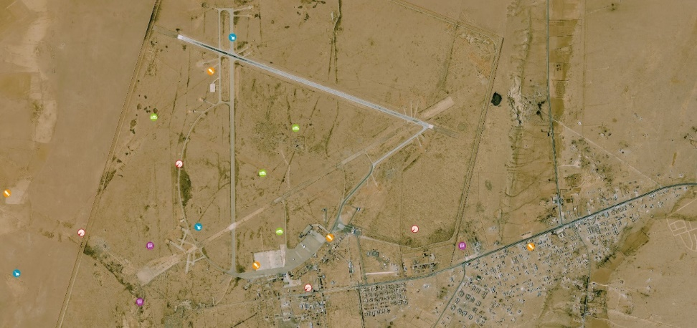
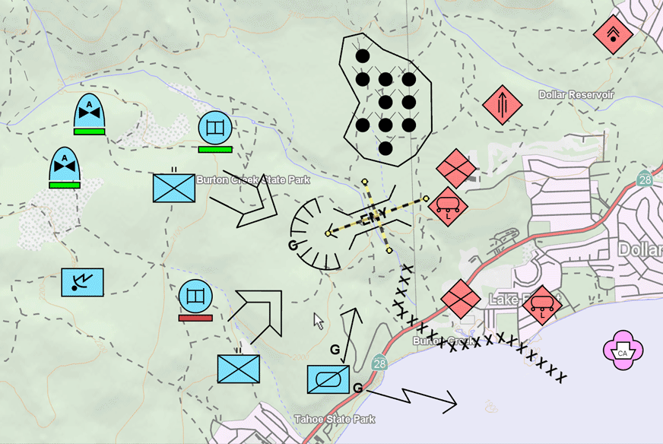
Shared Situation Awareness
Common Operational Picture
Track Fusion
Graphical presentation
MIL 2525D Symbology
GIS Overlay
GIS Chart underlay
Satellite Imagery Supported
Tactical Layer super imposed
Blue Force Tracking
Friendly forces position shown
All fixed and mobile assets updated
Clear segregation of Blue and Red force assets

Slide 50
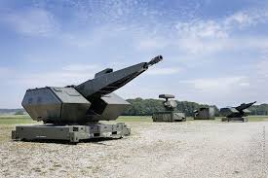
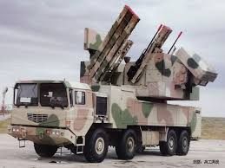
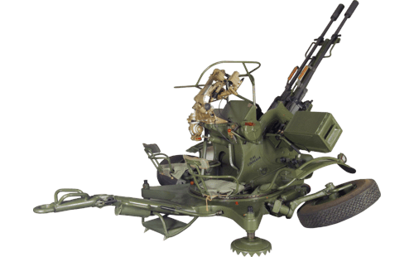
Air Defense
Real Time Air Picture from Sensors
Air Defense Planning
Track Identification (IFF)
Air picture at all command centers and Weapon Systems
Manual, Semi-Automatic and Automatic target Assignment
Complex Real time Threat Evaluation and Weapon Allocation algorithms
Command and Control of Air and Ground Assets

Slide 51
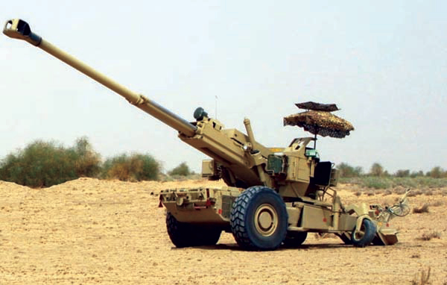
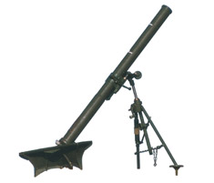
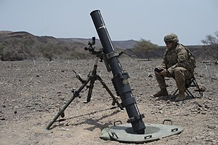
Fire Support
Support for mortars, field artillery cannons, rockets and missiles
Components are:
Field Artillery Fire Support System ( Direct Fire Support System)
Mortar Fire Support System ( In-direct Fire Support System)
Naval Gun Fire Support System
Attack Helicopters Fire Support System
Close Air Fire Support System
Fire Support System includes
Fire Support Planning
Target Management
Ammunitions Effects Analysis
Fire Support Execution

Slide 52
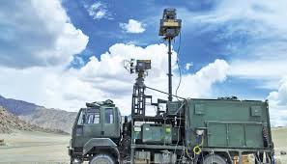
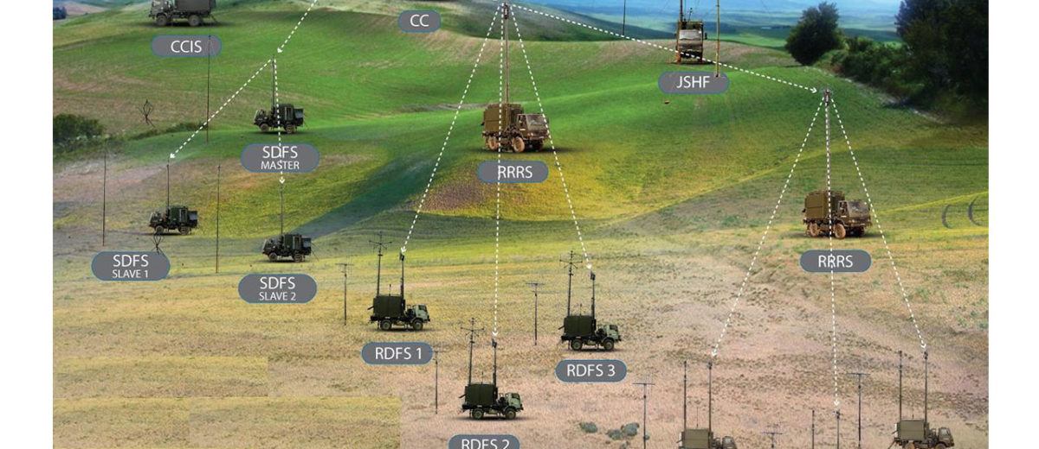
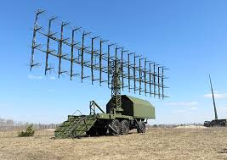
Intelligence & EW
Following components
Electronic Support Measures
Electronic Counter Measures
COMINT Data Integration
SIGINT Data Integration
Persistent Data Integration

Slide 53
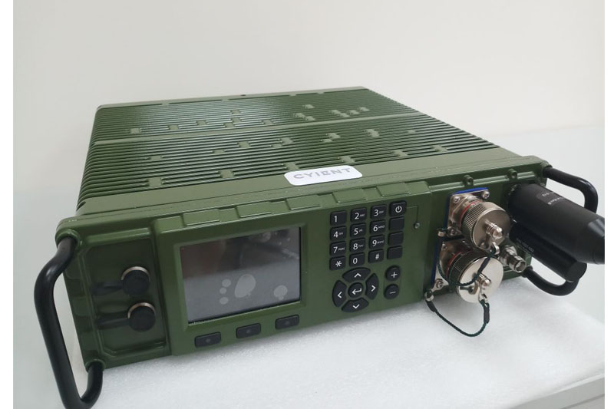
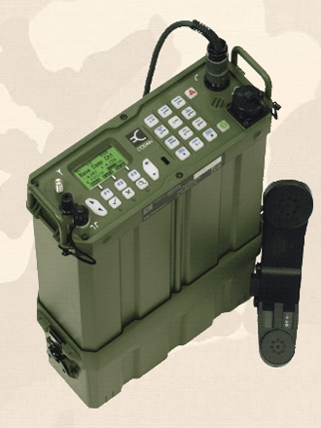
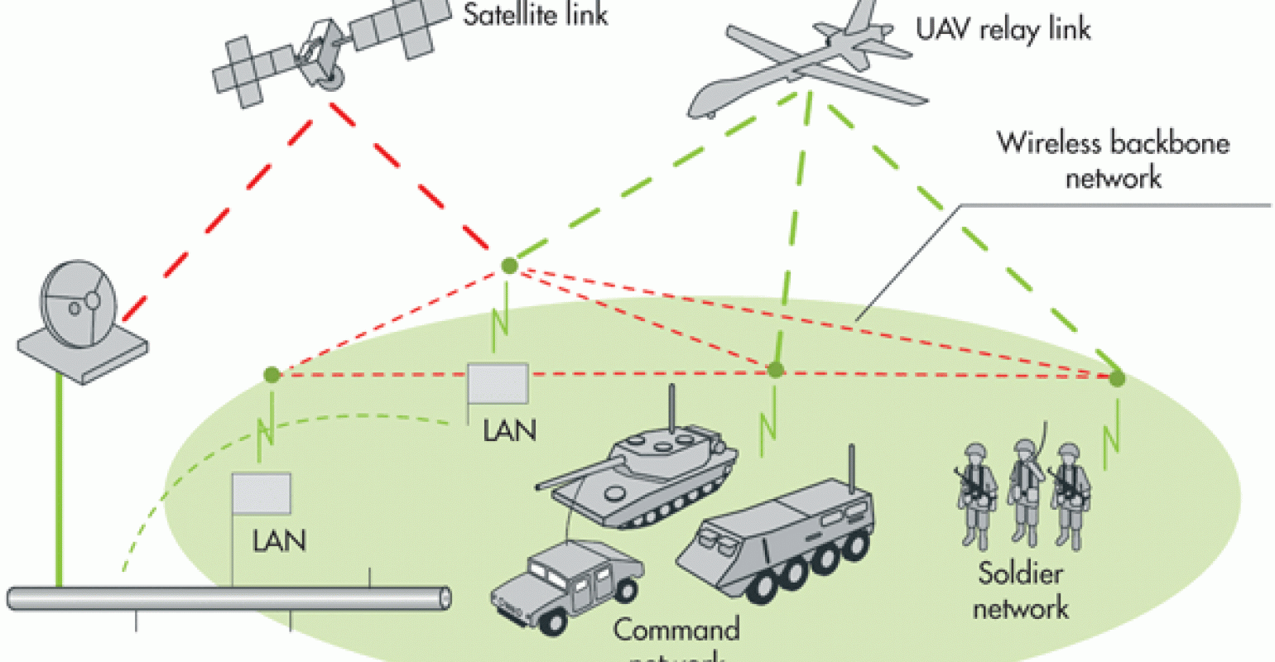
Communication
Common picture of battlefield in near-real time
Share data among battlefield systems.
Fusion and display of intelligence information to commanders at all levels
Exchange of targeting data from sensor to weapon systems.
Consists of the following Components
Strategic Terrestrial Network
Multi Channel Tactical Network
Last Mile SDR based Wireless Network

Slide 54
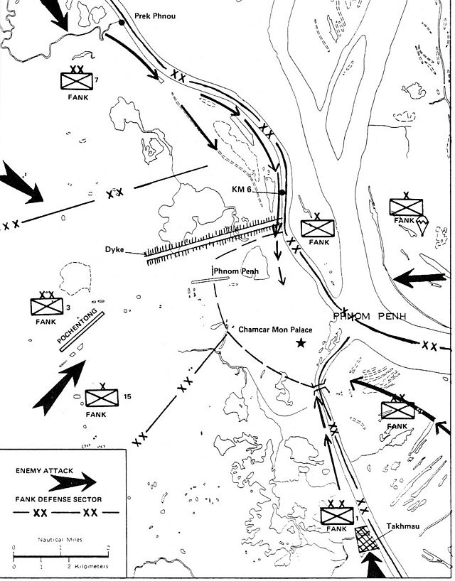
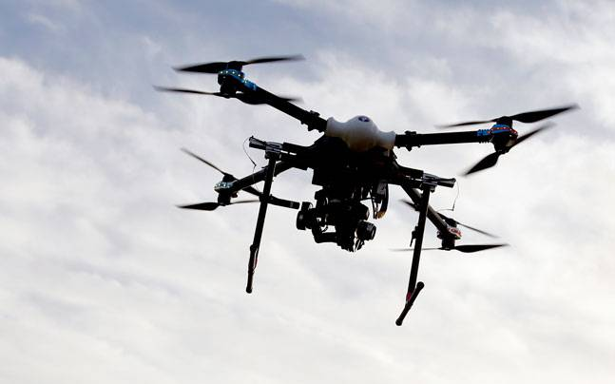
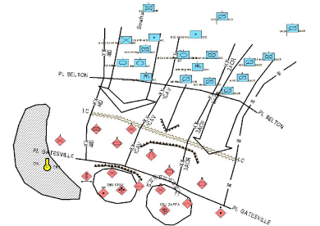
Battlefield Management
Following Components
Mission Planning
Plan / Order Creation and Dissemination
Movement Planning and Control
Operational and Logistics Status
Military Reports and Messages
Decision Support and Automation
Sensor Management
Autonomous Vehicle Command & Control
Interoperability with Other Armed Forces Systems

Slide 55
Summary of Development Framework

Slide 56
Overview of Capability
Top Down Design
Fire Support System
DCCS
Counter UAV System
Flight Control System
Systems
C4ISR Data Ontology
C4ISR Design & Development Framework
System of Systems
BMS
CMS
IACCS
Multi Level Systems
C4ISR Building Blocks
Strategic Level
Operational Level
Tactical Level
Multi Domain Operation Systems
Land
Sea
Air
Space
Cyberspace
Bottom Up Analysis

Slide 57
Discussions / Questions

