Slide 1


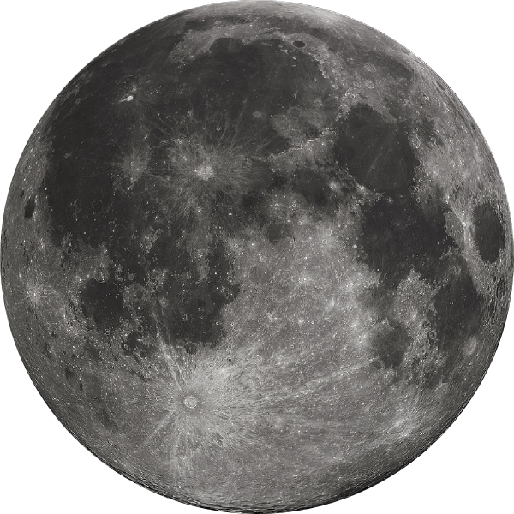
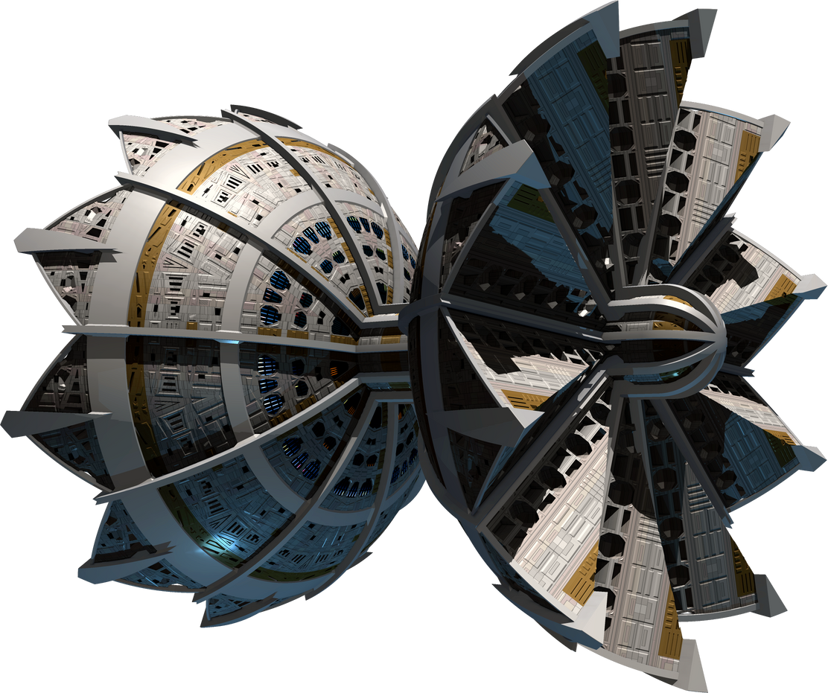
INDSPACEX 3.0
MULTI-DOMAIN OPERATIONS EMPOWERED BY SPACE
Let’s Get Started

Slide 2
INDSPACEX 3.0
•AN INDUSTRIAL TABLE-TOP EXERCISE FOR SPACE OPERATIONS – TRAINING PURPOSES.
•BASED ON CONTEST BETWEEN TWO NOTIONAL SPACE FARING ADVERSARIES CLAIMING SUPERIORITY - TO DRAW OUT LESSONS
•ALL MEMBERS PRESENT ARE PARTICIPANTS .
•SCENARIOS ARE NOTIONAL YET CLOSE TO REALITY.
•EXAMPLES FROM CURRENT ONGOING AND RECENT CONFLICTS ARE WELCOME.
•KNOWLEDGE OF INTERNATIONAL TREATIES , CONVENTIONS AND LAWS BE KEPT HANDY.
•TIME IS OF ESSENCE – REMAIN SHARP , BRIEF AND AUDIBLE.
ORANGE AND GREEN SPACE FORCES

Slide 3
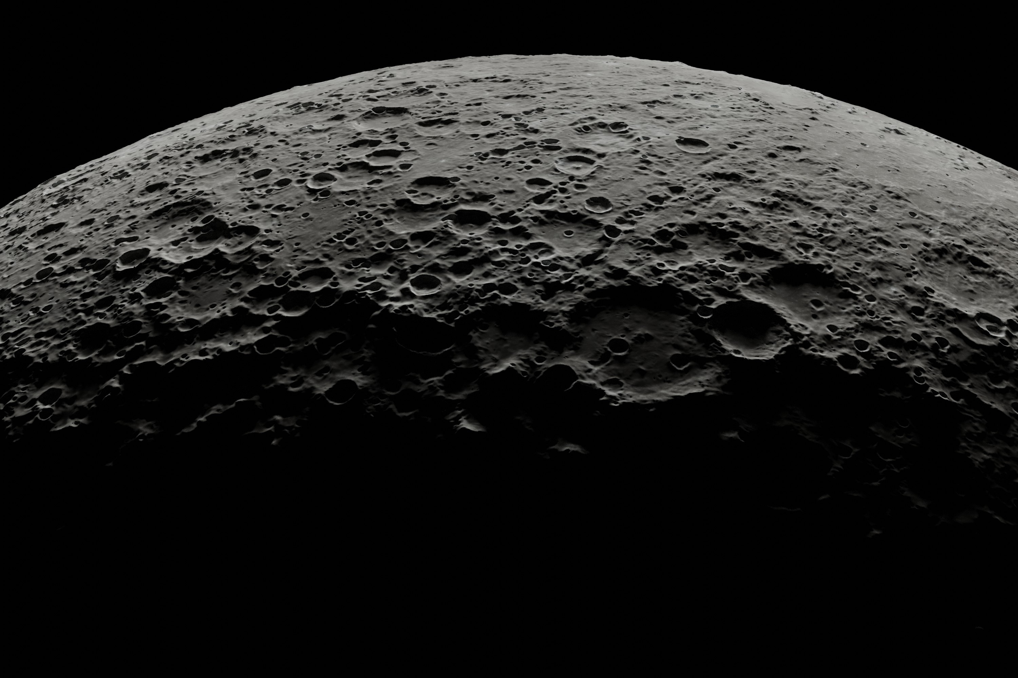
INDSPACEX 3.0
ORANGE SPACE FORCE
GREEN SPACE FORCE
•DEVELOPED INDUSTRIAL COMPLEX
•DEVELOPED R&D
•ECONOMIC HEFT ?
•REVISIONIST POWER (S)
•PROACTIVE WAR STRATEGIES
•CLAIMS – WRITES RULES.
•LEVERAGES PROXIES.
•MILITARY READY FOR CONFLICT.
•DEVELOPING ECONOMY
•NASCENT R&D
•DEPENDENT ON TOT
•ADVOCATES ADHERANCE TO CONVENTIONS
•HIGH GEOPOLITICAL IMP
•AUTONOMY – COLLABORATION/ PARTNERSHIPS / ALLIANCES ?
•ADVERSARIES – IN MIL CONFLICT

Slide 4
IndSpaceX 3.o
Degree of Severity
Definition
1. Disrupt
2. Deny
3.Degrade
4. Destroy
5. Info War- Delay
6. Info War- Deceive
1. Is the temporary partial impairment of the utility of space systems, usually without physical damage to the space segments.
2. Is the temporary full elimination of the utility of the space systems, usually without physical damage.
3. Is the permanent partial impairment of the utility of space systems, usually with physical damage.
4. Is the permanent full elimination of the utility of space systems, usually with physical damage.
5.Is the temporary delay of the information a space system provides, usually without physical damage.
6. Those measures designed to mislead the enemy by manipulation, distortion, or falsification of evidence to induce the enemy to react in a manner prejudicial to the enemy’s interests.

Slide 5
TYPICAL MDO - COMMAND AND CONTROL
 | ISR | MESHED INT | AI – PROCESS | WEAPONISE-IMPACT/ AUTO
Level of Command | Observe | Orient | Decide | Act
Strategic | National Int Agency | National Int Centers | CFSCC ( Combined Force Space Comd) | Theatre forces
Operational | SSN (Space Svl Netwk) | Space Int Centre | CSpOC/ NSDC (Cent Sp Op/Nat Sp Dec Centre) | SCN (Sat Cont Netwk)
Tactical | On- Board Sensors | On-Board Sensor Fusion | On-Board Decision Algorithms | On-Board Execution Algorithms

Slide 6
SCENARIO 1 (15 mins)
NARRATIVE
Merchant oil and cargo ships flash SOS - SLOC interference. 500 nm.
Fishing boats 12 to 20 nm from coast make suspicious maneuvers. Coast Guards report unusual communications – no contact.
ISR Drone : loses control – crashes.
Reports of an uninhabited island show presence of force/ irregulars ?
Two Carrier Groups, one supported by sub-surface force present in the ocean- One CG reported twice ? - Contradictions ? Ghost ?
REQUIREMENT
Green
Assessment ?
Response ?
Agencies involved ? Coordination ?
Orange
Any advantage taken ?
Judgement
Evaluate
Chair – National Coordination.

Slide 7
SCENARIO 1 A (18 mins)
NARRATIVE
Merchant oil and cargo ships flash SOS - SLOC interference. 500 nm.
Fishing boats 12 to 20 nm from coast make suspicious maneuvers. Coast Guards report unusual communications – no contact.
ISR Drone : looses control – crashes.
Reports of an uninhabited island show presence of force/ irregulars ?
Two Carrier Groups, one supported by sub-surface force present in the ocean- One CG reported twice ? - Contradictions ?
REQUIREMENT
Green
Need spot/identify/ intention of adversary on Z day-250 nm (Red line).
How can space assets assist ?
Resolutions ? Ocean ? Island ?
How Info War – called out ?
Orange
What would you do to disrupt from Space ?
Means of deception and disruption ?
Judgement
Rules of Engagement ?
Justification of technology ?
Evaluate
Chair – Quantify (No and type of Space assets)

Slide 8
SCENARIO 2 (25 mins)
NARRATIVE
Unverified reports…
14 adversarial Airfields/ Helidromes activated.(60 – 500 kms depth)
No Identity on class of ac.
Own Air Force reports adverse EW environment. Nav spoofing common. Drone swarms hazard.
Sat Center under Cyber attack.
Airforce asked to destroy 6 Bridges (precision) at BVR, and take out 8 airfields.
Target list : Troops and Tank concentrations, railway sidings, dam, power grid and ammunition dump.
REQUIREMENT
Green
Threat Assessment – confirmation of reports ?
How do we overcome adverse EW environment ?
How can space assist in precise targeting ? PSDA
Help in Close Air support ? Bomb Line.
Orange
How you deny use of space ?
Hide and deceive ?
Resources needed ?
Judgement
Declaration of war status – act of war ?
Fair use of dual use assets ?
Technology essentials ?
Chair – Quantify technology and Scale of assets needed.

Slide 9
SCENARIO 3 (15 mins)
NARRATIVE
Increase in Infiltration – crime syndicates.
Detect two tunnels.
Use of Small drones – medium drones on the rise.
Communication transmission – increase.
Coastal patrols see suspicious movement in mangroves/ marshy area.
Tanks/ Arty stage forward increasingly.
Hamas type Zero Day ?
D day imminent ?
REQUIREMENT
Green
Sub-terranean Operations - tunnel detection ability ?
Incremental use of drones - MDO and Space.
Inter-service/ministry Intelligence network required for COP.
Meshed operations- role of space ? C2
Orange
How do you disrupt ( Space-tech) before offensive ?
What pre-emptive actions would you take ?
Judgement
Evaluation on all of nation/ Government.
Tech integration – without tech clutter.
Chair
Role of Space Agencies, R&D and Industry.

Slide 10
SCENARIO 4 (25 mins)
NARRATIVE
Green and Orange are short of War – volatile international environment.
Green land forces in Defence.
Orange build up - obscure.
Cyber Attacks from space – power grid collapse. IoBT grid disrupted.
Own rocket looses control as it enters space.
Sudden gap in ISR
Reported ASAT attack on third country.
PNT grid switched off- unreliable.
Direct and precise missile attack on enrichment plant. Threats for more.
Decision Dilemma on any pre-emptive.
REQUIREMENT
Orange
Pre-emptive strategy ?
What and how do you degrade/destroy ?
Preparing for ideal ground offensive.
Green
Need assessment on adversary
Intentions, time and quantum of threat. Detection of roads, bridges, vehs, tanks, troops 24X7.
Effort needed for persistent ISR. ELINT – ISR for IPB.
Analytics – for reduced OODA ?
How do we protect own assets from space offensive ?
What efforts needed for deep and precise targeting ?
Defence against hypersonic ?
How can private players assist ?
Restoration strategy and drills ?
Judgement
Preparation levels
Tech deficiencies and priorities
Chair
Priorities that green land needs to focus on.

Slide 11
SCENARIO 5 (20 mins)
NARRATIVE
ASAT / Counter Space
Own satellite had been hit.
PNT
COMN
ISR
Triad Assurance levels ?
REQUIREMENT
How do you investigate the reason for sudden collapse.
Prevent.
Inspect /
Restore ?
Repair ?
Counter ?
Alternatives ?

Slide 13
COLLECTIVE REQUIREMENT (25 mins)
NARRATIVE
PNT need for Defence ?
Bandwidth and Spectrum needs for TBA 200x200 kms IoBT- 5G/6G.
ISR assets required to cover India’s frontier / Regional and Global coverage. EO/SAR/ Elint.
AI/Analytics platforms and standards
What assets are required for precise deep strike with ac and msls ?
MDO needs shortening of OODA , C2 and data. How can this be achieved from Decision Support to Battlefield management ?
How can manned missions be useful for Military application ?
Net Assessment of Defence Space ? – INDUSTRY CAPABILITY

Slide 14
CAPABILITY MAPING ( 25 mins)
NARRATIVE
No of EOI/RFI
Communication - ISL
PNT
ISR – EO, ELINT, SAR – Resolutions
For Small, Med and Large.
For LEO, MEO and GEO
Hyperspectral Images
Data Library - analytics
Computing
ASAT/ Counter Space Alternatives.
SSA
REQUREMENT
Cost of Launch
Cost of Satellite
Cost of Service
Time of Delivery (R&D to Launch)
Life – Enhancement/ Replacement.
Orbital Efficiency for each for India - Revisit
ITU Formalities
Freq and Spectrum
On Demand

Slide 15
OPEN ISSUES
Question Hour

Slide 16
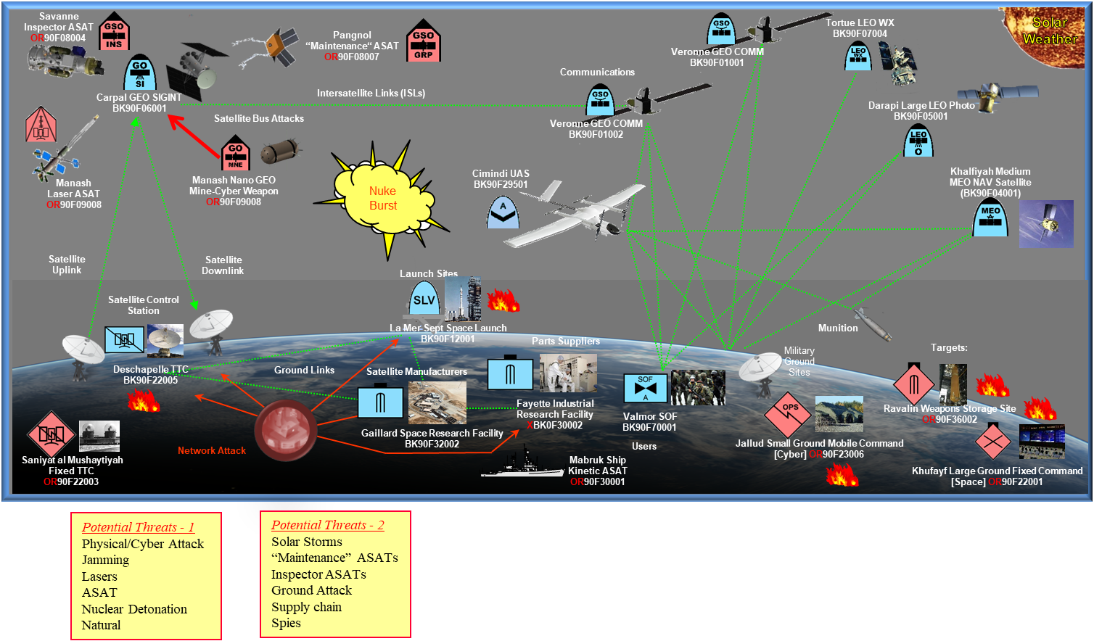
INDSPACE X 3.0

Slide 17
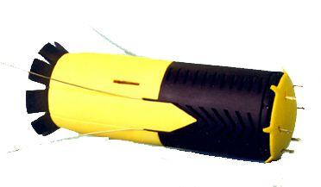
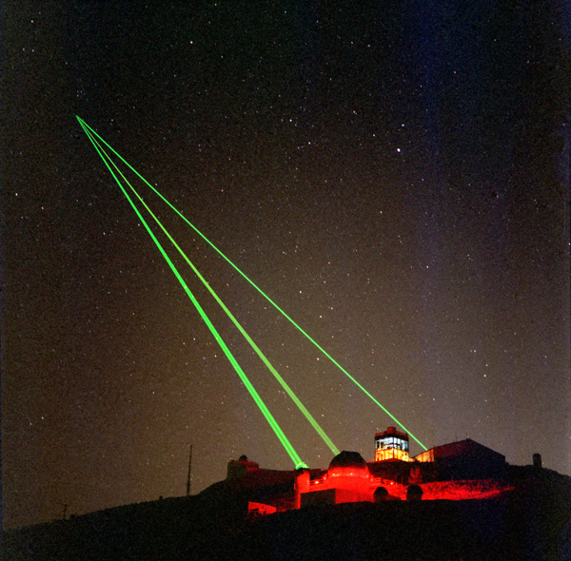
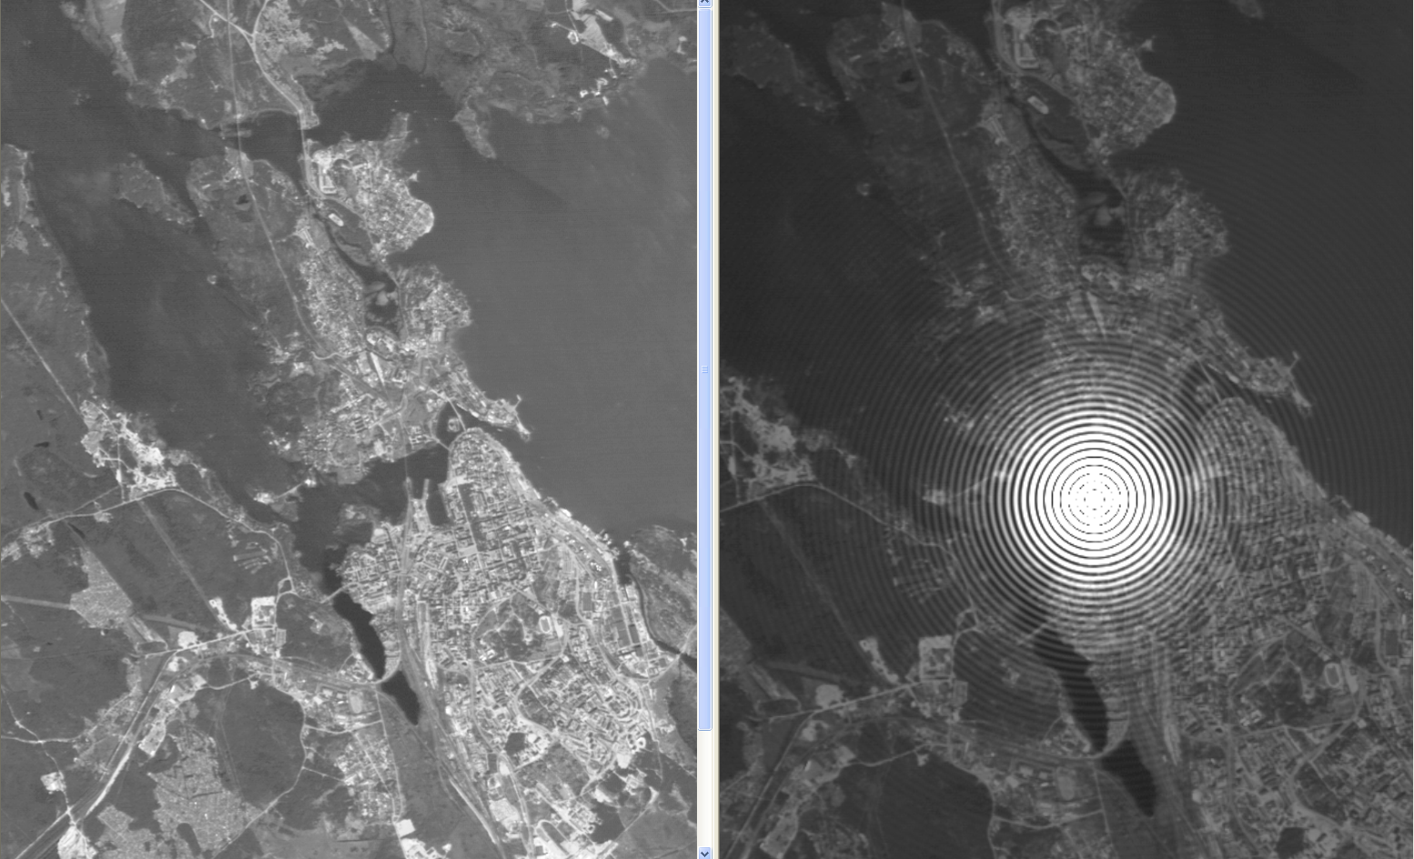
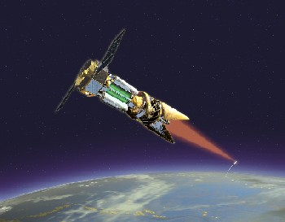
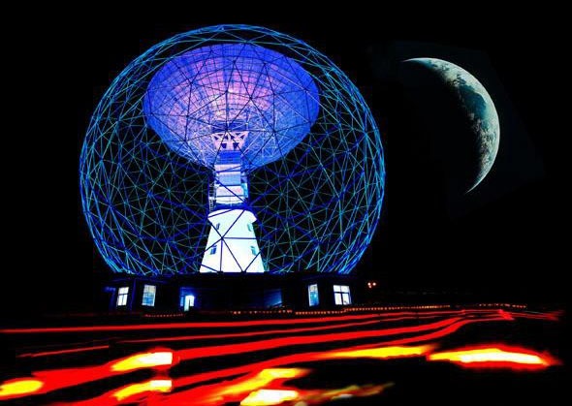
Means of Attacking Space Systems
Diplomatic, Economic
Attempt to Limit Adversary Countries’ Development, Deployment & Employment of Space Systems that May Threaten Nation’s Interests
Cyber
Jamming, Spoofing, Hijack Satellite
Point Satellite Sensors/Heat Exchangers to Sun
Randomly Spin Satellite
Randomly Turn Off Satellite Sub-Systems
Induce Satellite to Burn Up Reserve Fuel
Directed Energy (Lasers, High Power Microwaves)
Blind Satellite Sensors (Imagery, Earth Limb, Star Trackers)
Destroy Satellite Systems with High Power Lasers

Slide 18
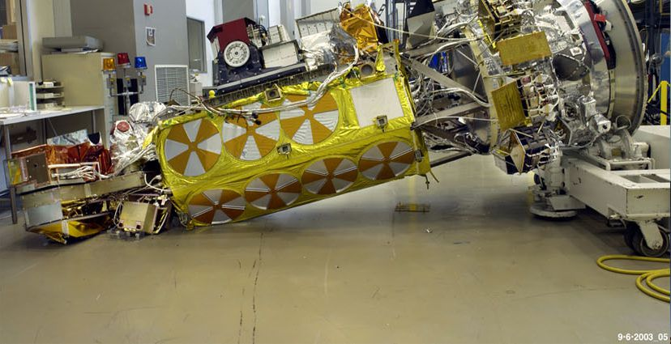
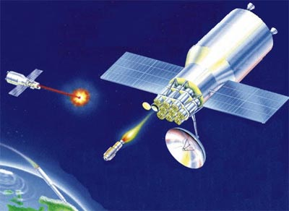
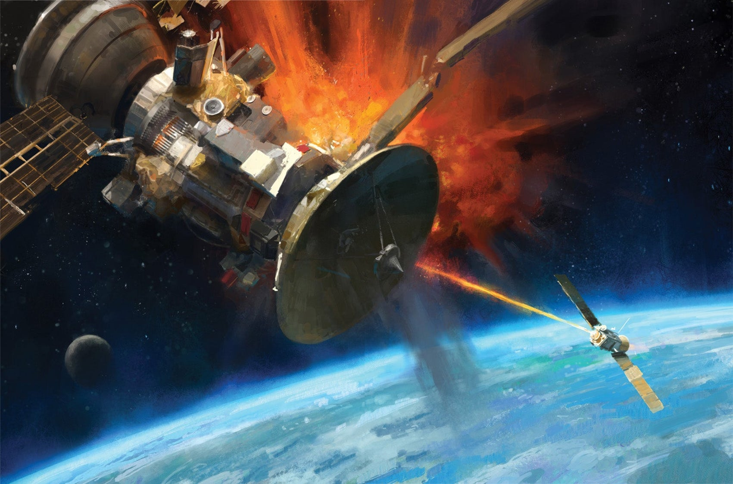
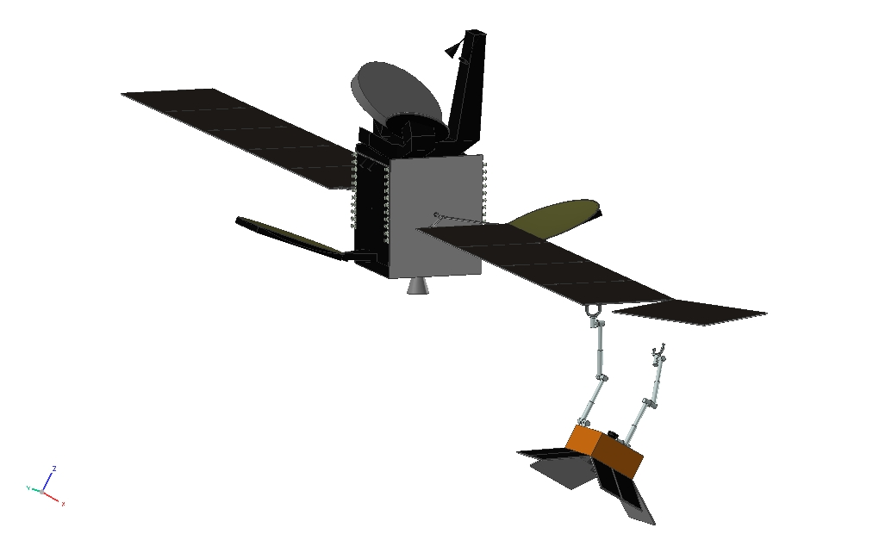
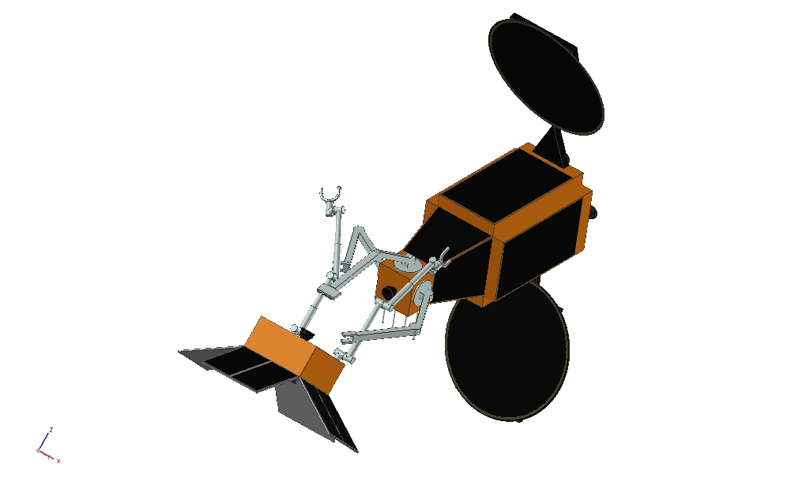
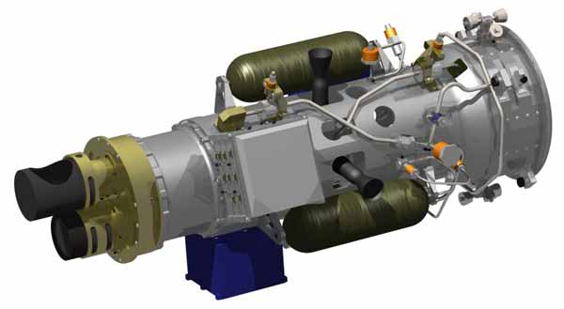
Means of Attacking Space Systems
Physical Attacks (Terrestrial Space Systems)
High Explosive Bombs on Target
Special Forces
Physical Attacks (Space-Based Systems)
Kinetic Kill Vehicle (KKV) - Causes Debris
Inspector / Maintenance Satellite in Close Proximity
Grab Satellite & Pull to Useless Orbit
Disassemble Satellite / Cut Wires
Paint Satellite Systems (Sensors, Solar Panels, Radiators, Antennas)

Slide 20
SCENARIO 6
X Country wants to make a net assessment of military and strategic capabilities of another nation using Space.
Infra.
Military Industrial Capability.
Energy capacity and vulnerability.
Prep for CBRN and Cyber status.
Space Domination
What should be the strategy ?
What capacities need to be built ?
What collaborations are possible ?
How do we achieve persistence in assessments to trigger warning ?
Counter measures for same ?

Slide 21
SCENARIO 7
Activation of TBA 150 Kms X 300 Kms
Autonomous drones, guns, tanks, missiles, Missile Defence,
Trans-border Special Forces
Air Force and Maritime Special Operations on flanks with Impact on TBA.
War Zone and Rear Areas IoMT
Assessment of spectrum and ground Infra for 10-15 TBAs.
Sudden Surge capacities ( LoD)

