Slide 1

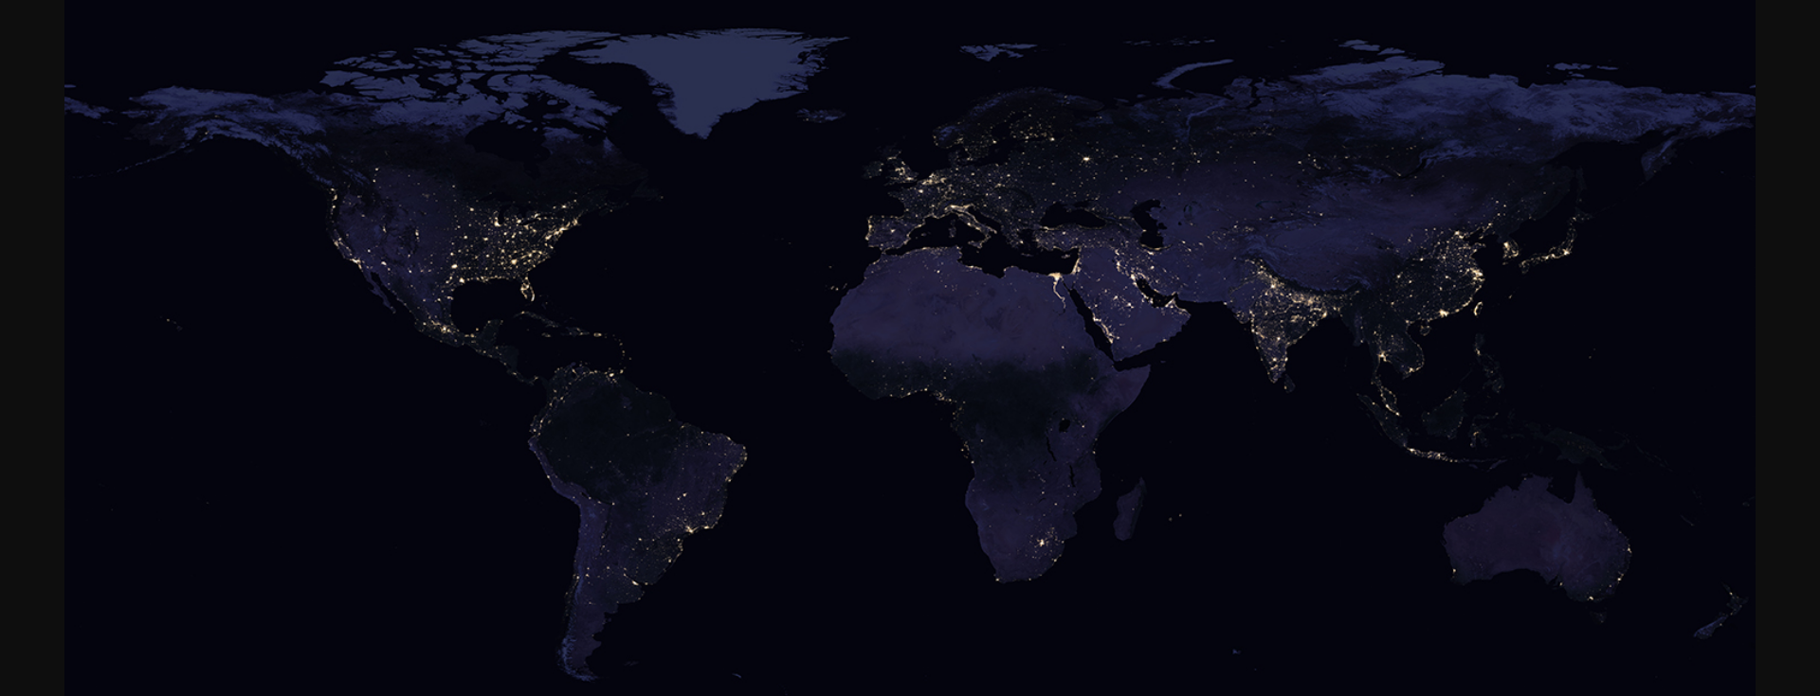
NON KINETIC WARFRAE
SECURING NATIONAL SPACE CAPABILITIES

Slide 2
BROAD FRAMEWORK
Define Resources
Assess Threat
Evaluate Loss
Assigning Safeguards
Secure Space Assets
Org
Value
Functionality
Segment
Natural
Manmade
Temp / permt
Vulnerability
Segment
Temp / permt
Svl
Comn
Net Wk
Navig
Proportional
Passive
Active

Slide 3
PILLARS FOR SPACE CONTROL
Protection of Space Assets
Surveillance
Prevention
Negation
Space Control

Slide 4
OP SPACE CAPBS
Detection & Reporting of Threats/Attacks
Identify, Locate and Classify Threats
Withstand and Defend
Sensors on space sys to detect and report anomalies
Space Management System (SMS) to receive, process, collate, fuse and disseminate info
Preserve assets using passive and active countermeasures
Reconstitute and Repair
Equivalence of both military and civil assets as National assets
Ability to recover lost ability through direct intervention / redundancies
Assess Mission Impact
Accurate assessment for commensurate action

Slide 5
FUNCTIONAL REQMTS FOR OP CAPB
Functional Requirements | IMPACT
 | Detect and Report Threats/Attacks | ID, Locate, and Classify Threats | Withstand and Defend | Reconstitute and Repair | Assess Mission Impact
1. Hardening/ Shielding of System Components
2. Developing Robust Space Management System (SMS)
3. Improving Space System Maneuverability
4. Protection of Ground Control and Ground Resources
5. Defensive Operations – Anti Jamming, Denial
6. Threat Warning and Assessment Reporting
7. Space Weather Sensor System
8. Mobile Ground Stations
9. Diagnostics and Repair Technology
10 Launch on Demand and Quick Launch Recovery
11. Modelling and Simulation

Slide 6
GOALS, LIMITATIONS & TECHNOLOGIES
GOALS | FUNCTIONAL CAPABILITIES | LIMITATIONS | KEY TECHNOLOGIES
Detect and Report Threats/Attacks
Detect & Report threat in near-real time | Robust Space Mgt System (SMS). Real time threat assessment. | Contacting satellite No auto assessment sys on-board satellites | Space svl and mapping Adaptive & secure comn link On-board intrusion detection AI/ML for data fusion Inter Satl Links (ISL)
Identify, Locate, and Classify Threats
Identify, locate & classify | Robust Space Mgt Sys (SMS). Real time threat assessment. | Real-time response Mapping the sky - Limited computational capacity Cataloguing orbital debris | Warning and assessment reporting AI/ML based processing techniques and data fusion Active HR imaging ELINT and SAR Capb
Withstand and Defend
Withstand and defend against threats | Hardening/shielding of sys Robust Space Mgt Sys (SMS). Improve manoeuvrability Protection of grnd segment | On-board detection and protection capabilities No self-defense capability Ability to validate hardening Microelectronics susceptible to radiation hazards Satellite debris Alt comd & control links | On-board self-shielding, hardening AI based orbital manoeuvring On-board diagnostics Space manoeuvre vehicles (SMVs) Space-based command and control/processing Edge Computing

Slide 7
GOALS, LIMITATIONS & TECHNOLOGIES
GOALS | FUNCTIONAL CAPABILITIES | LIMITATIONS | KEY TECHNOLOGIES
Operational Capability Element: Reconstitute and Repair
Reconstitute and repair space services | Improve system manoeuvrability Improve diagnostics Provide quick-launch and recovery | Infra vulnerabilities Replenishing satellites | Alternate grnd control stns Launch on Demand Vehs Satl storage Agile telemetry, tracking & cont
Operational Capability Element: Assess Mission Impact
Assess mission impact/ disseminate | Robust Space Mgt System (SMS). Modelling and simulation | Validation of survivability of sys and ground stns Limited on-board diagnostics | Advanced processing techniques and data fusion Advanced modelling and simulation

Slide 8
SUMMARISED FRAMEWORK
SPACE
CAPABILITY
OBJECTIVE
PROTECTION OF SPACE ASSETS
Detect & Report Threats/ Attacks
Identify, Locate,
Classify Threats
Withstand & Defend
Re-constitute & Repair
Assess Mission Impact
OP IMPERATIVES
Space Domain Surveillance and Awareness Sys
On-board intrusion detection and prevention sys
Adaptive and secure comns for space to ground cont
Hardening and shielding against EM & Space Radiations
Onboard diagnostics
AI/ML based calibration ; orbital maneuver
Launch on Demand
Space Mgt Sys for AI/ML based data fusion & Dissemination
Inter Satl Links (ISL)
Edge Computing
ENABLERS

Slide 9

JAI HIND

