Slide 1
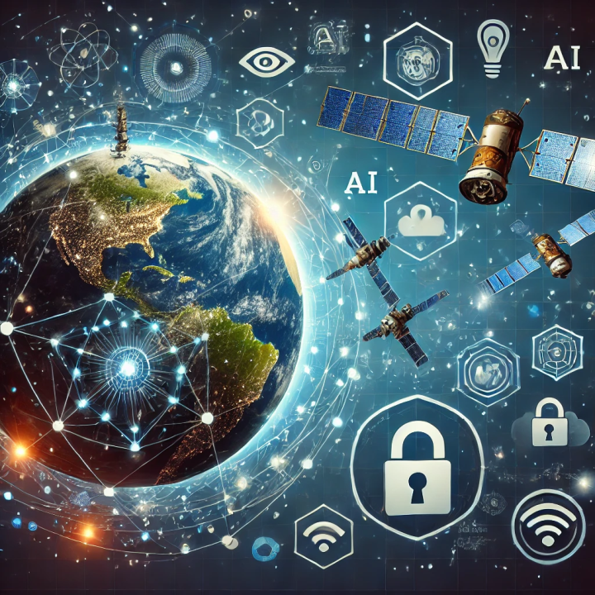
Cyber Shield For Space: Integrating Space & Cyber

Slide 2
The future of Cybersecurity in Space relies on the understanding by all of us that Space assets and services are heavily intertwined with and rely on terrestrial infrastructures and vice versa, every day 24/7, for services that we as end users see as being obvious and available by default.

Slide 3
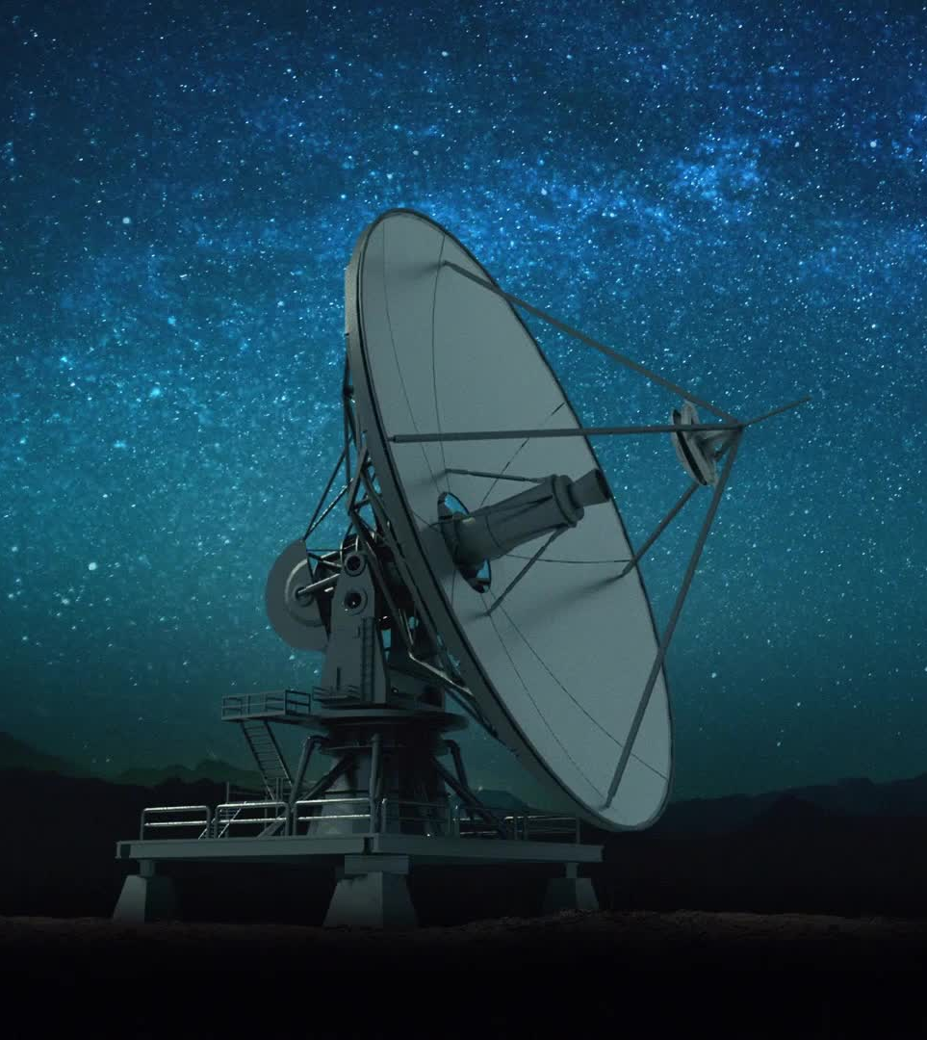
The importance of satellite and space cybersecurity in this new digital era is due to our integral reliance on space, specifically satellites, for communications, security, intelligence, and business.
A breach in space cybersecurity can have catastrophic consequences for global security, economic stability, and individual organizations.

Slide 4
Space Ecosystem
The increasing size, scale, and interdependence of space technologies across countries and between different actors requires a new level of cybersecurity capabilities.
  By 2030, 25,000 satellites carrying over 500,000 petabytes of data will be launched.
Space is an attractive proposition for cyber criminals.
Academia can and does play a key part in supporting the space sector through innovative research and education.
Secure by design cyber resilience must be an essential part of any Space business. Executives in the space sector need sector-specific cyber resilience training.
International cooperation between governments and organizations in implementing cybersecurity measures to protect their space systems and infrastructures from cyber threats is therefore more important than ever.

Slide 5
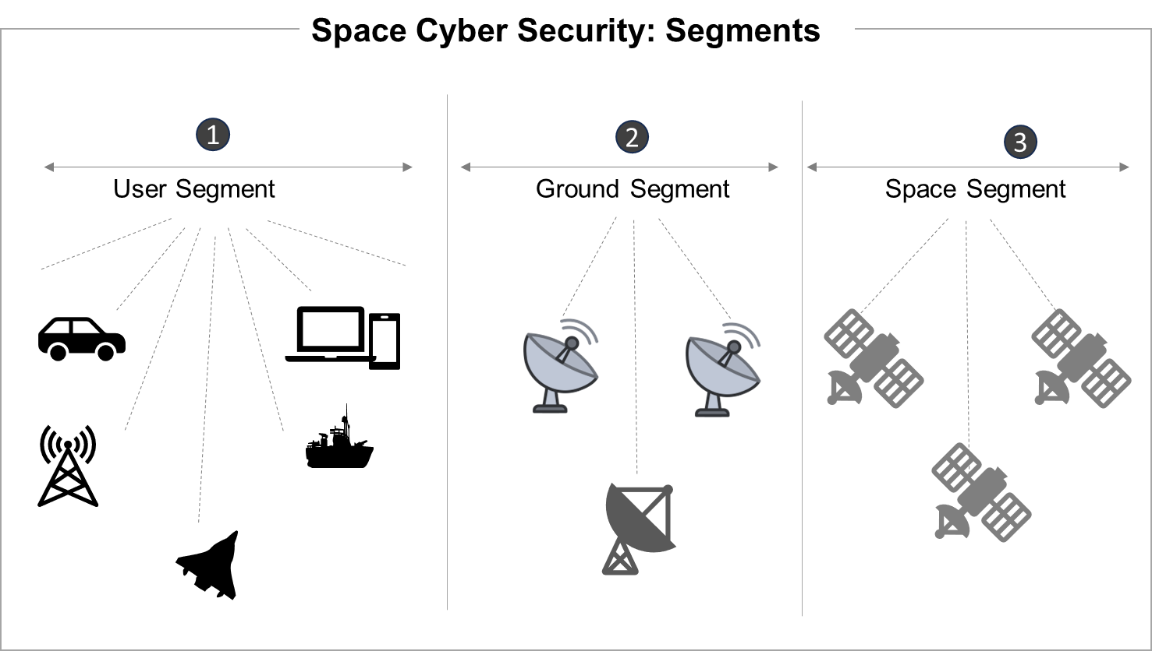

Slide 6
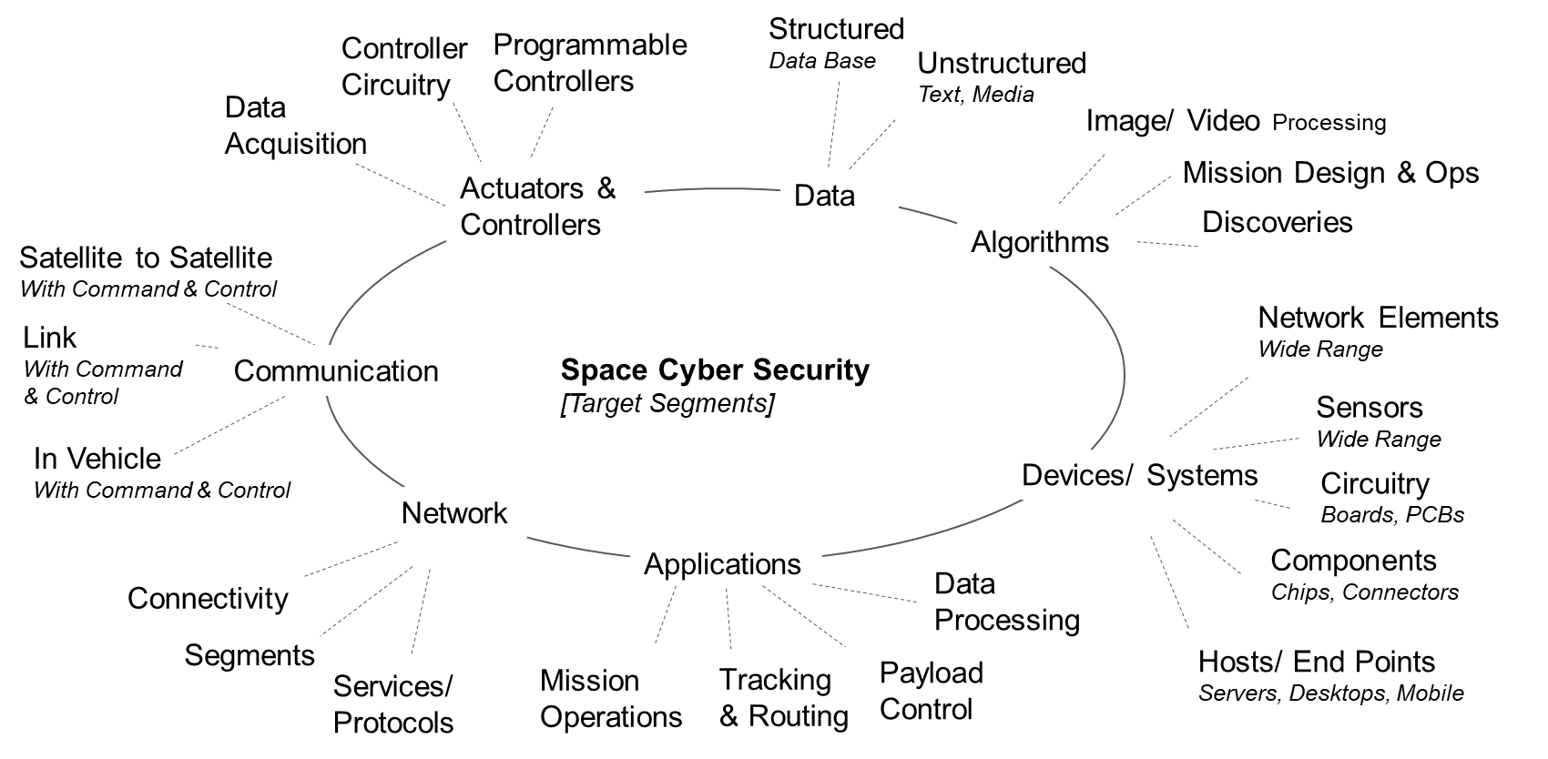
What is at Risk?

Slide 7
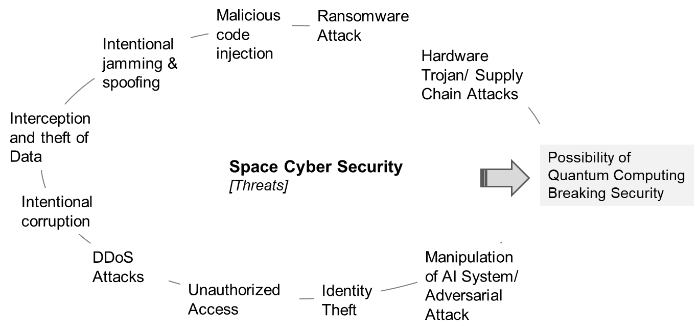
Space Sector: Threat Landscape

Slide 8
Digitization
Security Architectures
Co-creation of Technologies
Dependencies on Critical Technologies
AI/ ML
Software Engineering
Research Strategies & Promotion
Incubation & Acceleration
Heightened Technology Geopolitics
Chip & Semiconductor
Wireless & Communication
Supply Chain Security
Productization, & Commercialization
Space Technology & Cyber Security
Threat Modeling & Security Research
Sensors, IoT, & Wearables
Challenges
Networking Overhaul
Increased Digital Footprint & Exposure
Technology Adoption Roadmaps
Product/ Devices Security
Advanced Material
3D Printing & Advanced Manufacturing
Advanced, Persistent & Targeted Attacks
Trials, & Integrations
AR/VR
State & Non-State Actors
Market Development
Training & Skill Building
Technology Advancements
Physical Facilities
Technology Infra & Lab
Team: (Technical & Program)
Programs Activities
(Co-creation, Acceleration | Assessments, etc.)
Research & Study
(Trends, Practices, Frameworks, Reference Arch)
Events & Training
(Trends, Practices, Frameworks, Reference Arch)
The solution is not just to be found in technology; it's also about innovative operational concepts, increasing awareness, sharing cyber solutions and cyber threat knowledge across the supply and value chains, and embracing security-by-design.

Slide 9
Promote cybersecurity & privacy awareness
Undertake programs to develop and nurture strategic thinking
Develop
Best Practices
Develop segment-based strategies
Promote crypto agility risk assessment
Accelerate the pace of Cybersecurity R&D
Build capabilities and expertise
Create a conducive policy environment
Assess architectural ideas, frameworks, and engineering evolutions
Promote cybersecurity and privacy innovation
Develop a platform to promote start-ups
Create opportunities for active exchange and deliberations
Organize challenges and hackathons
Measures & Interventions for
mitigating Risks to Space Sector

Slide 10
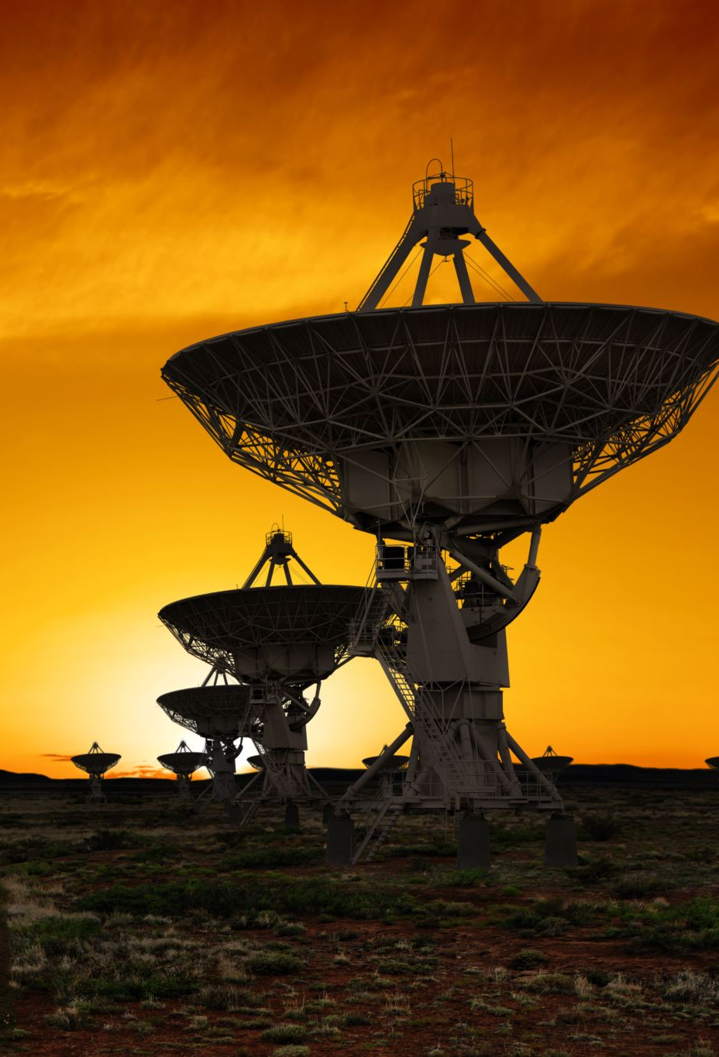
Increased Reliance on Space-Based Technologies
Growing Dependence:
Communication: Satellites facilitate global communications, including internet, television, and emergency services.
Navigation: GPS and other satellite navigation systems are crucial for transportation, logistics, and everyday activities.
Earth Observation: Satellites monitor climate change, natural disasters, and agricultural trends, providing valuable data for decision-making.
Defense and Security: Space assets are integral to national security, providing intelligence, surveillance, and reconnaissance capabilities.

Slide 11
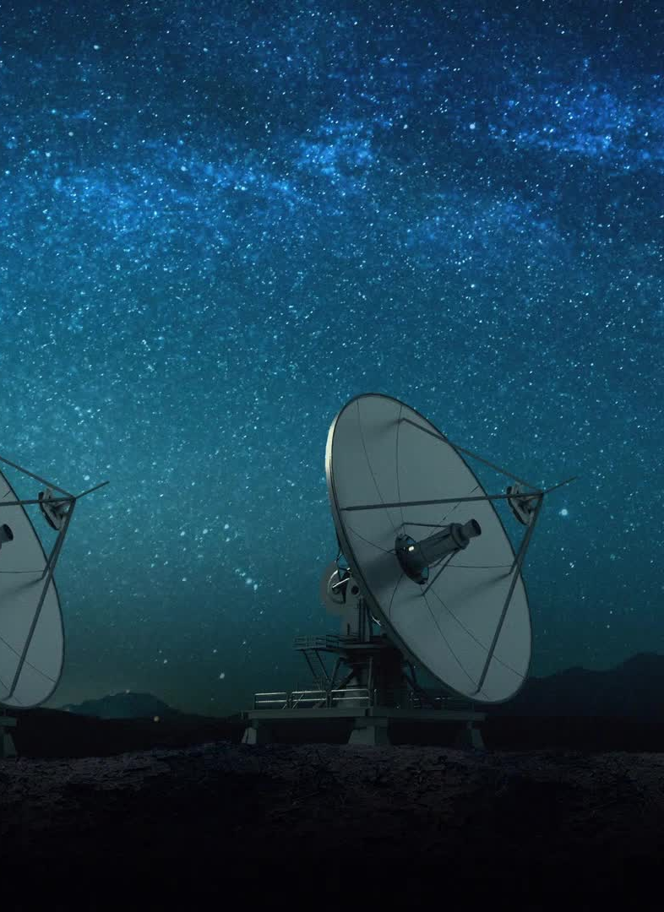
Emerging Cyber Threats to Space Assets
Threat Landscape:
Hacking and Cyber Attacks: Satellites and ground stations are vulnerable to cyberattacks that can disrupt services, steal data, or take control of spacecraft.
Jamming and Spoofing: Electronic warfare techniques can interfere with satellite signals, affecting communications and navigation systems.
Supply Chain Vulnerabilities: The complexity of the space supply chain introduces potential points of entry for malicious actors to exploit.

Slide 12
Enhancing Cybersecurity Measures
Defensive Strategies:
Encryption and Secure Communication: Implementing advanced encryption methods to protect data transmitted to and from satellites.
Robust Authentication Protocols: Ensuring that only authorized entities can access and control space assets.
Intrusion Detection Systems: Developing systems to detect and respond to unauthorized access attempts in real-time.

Slide 13

Regulatory and Policy Frameworks
Governance and Compliance:
International Cooperation: Establishing international norms and agreements to enhance space cybersecurity, like efforts in terrestrial cyberspace governance.
Regulatory Standards: Developing and enforcing standards for cybersecurity in space systems, including guidelines for satellite manufacturers and operators.
National Policies: Governments will create and enforce policies to protect their space assets and critical infrastructure.

Slide 14
Technological Advancements
Innovative Solutions:
Quantum Cryptography: Utilizing quantum technology to create virtually unbreakable encryption for secure space communications.
AI and Machine Learning: Employing AI to detect anomalies, predict cyber threats, and automate defensive responses.
Resilient System Architectures: Designing satellite systems with built-in redundancies and the ability to isolate and mitigate cyber threats.

Slide 15
Future Trends and Considerations
Long-Term Outlook:
Space Traffic Management: Developing systems to manage the increasing number of satellites and avoid collisions, which can have cybersecurity implications.
Cybersecurity for Space Tourism: As space tourism becomes more prevalent, ensuring the security of private space missions will be critical.
Protection of Deep Space Missions: Securing missions to the Moon, Mars, and beyond from cyber threats will be a growing concern as human exploration extends further into space.

Slide 16
Public-Private Partnerships
Collaborative Efforts:
Joint Initiatives: Collaboration between governments, private companies, and international organizations to share information and develop collective defense mechanisms.
Investment in R&D: Increased funding for research and development in space cybersecurity, fostering innovation and the deployment of cutting-edge technologies.
Cybersecurity Training: Enhancing the skills and expertise of the workforce through specialized training programs and certifications in space cybersecurity.

Slide 17
Conclusion
The future of space and cybersecurity is intricately linked, with both fields evolving rapidly in response to new challenges and opportunities.
As space-based technologies become more integral to daily life and national security, protecting these assets from cyber threats will be paramount.
This requires a multifaceted approach, including technological innovation, robust regulatory frameworks, international cooperation, and public-private partnerships.
By addressing these challenges proactively, we can ensure the continued growth and security of the space economy, paving the way for a safer and more connected future.

